Slide 1
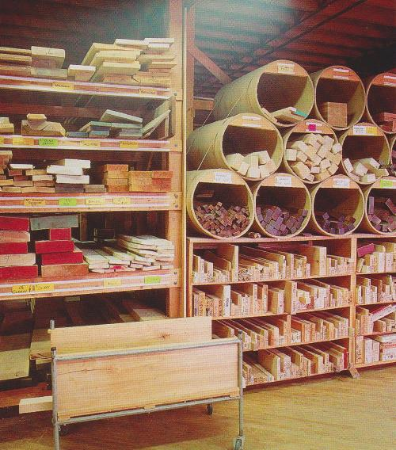
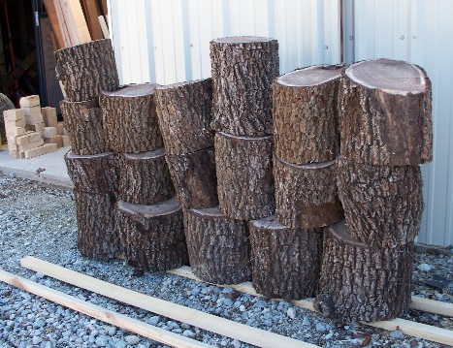
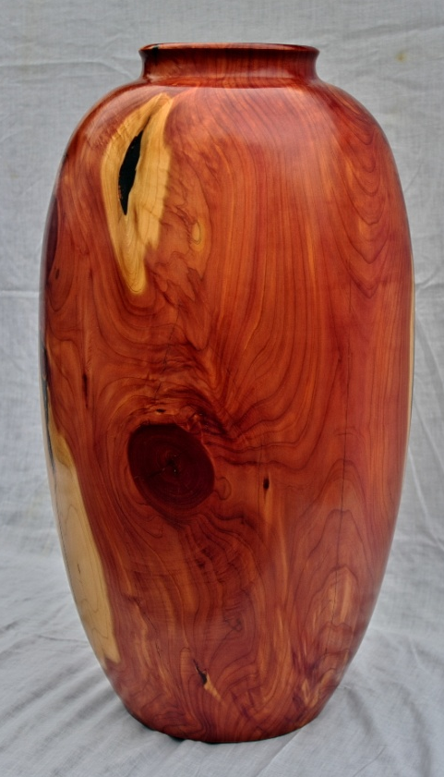
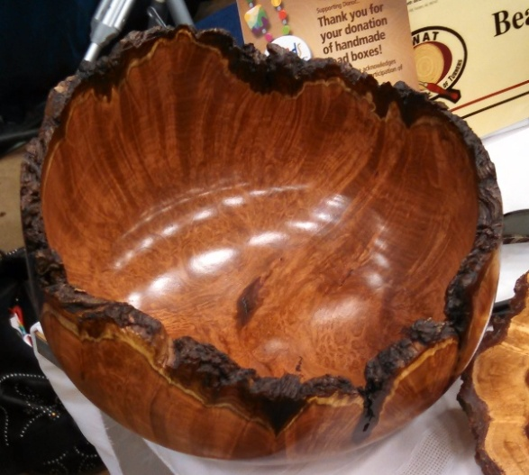
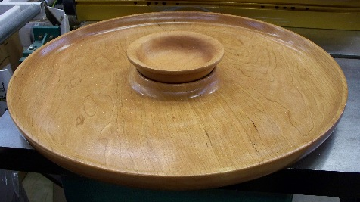
Choosing the right wood for your woodturning project
By: George Freeman

Slide 2
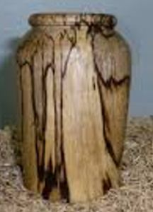
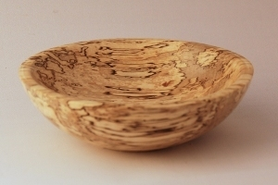
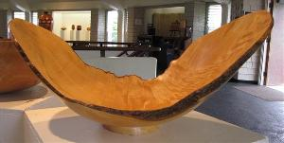
Choosing the right wood
1100 species of native trees in the United States
One-half of them are found in the South
200 species of trees are native to Texas
This number does not include the many hybrid cultivars of trees available in the nursery trade for landscaping (that can be used for woodturning).
This presentation will cover over 50 of the native trees of Texas as well as some from North America with an emphasis on the kinds of wood they produce for turning.

Slide 3
Cost of Wood Turning Blanks
American Hardwoods | Price Per Board Foot (8/4 lumber)
Cedar - Aromatic | 4.00
Ash | 4.60
White Oak | 4.85
Maple | 7.50
Black Cherry | 9.50
Walnut | 9.50
Mesquite | 17.00
Foreign Hardwoods | Price Per Board Foot (8/4 lumber
Purpleheart | 11.00
Bubinga | 17.00
East Indian Satinwood | 35.00
Ziricote | 48.00
Cocobolo | 58.00
Tulipwood - Brazilian | 65.00
Brazilian Rosewood | 85.00
African Blackwood | 95.00
Gabon Ebony | 110.00

Slide 4
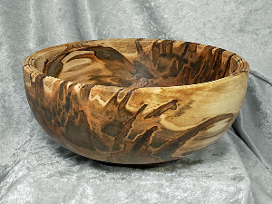
Sources for information about wood
Landscaping books
Covers nursery grown trees not native trees.
Forestry books
Covers identification of trees not what kind of wood is in a tree.
Arbor day books
Covers identification of trees not what kind of wood is in a tree.
Woodworking books
Covers how to use a plane, saw or chisel, not about the kinds of or characteristics of wood.
Internet
Results depends or your search query – be specific.

Slide 5
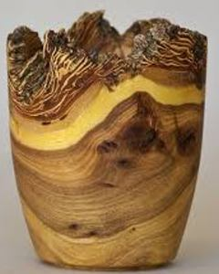
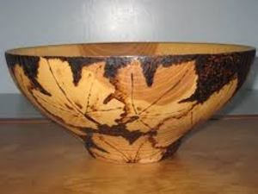
Choices for turning:
White – Brown – or Black colored wood?
Example: Hackberry, Catalpa or Walnut
Fine grain or course grained woods?
Example: Holly, Cherry or Oaks?
Stable woods or other woods that may warp, shrink or crack easily?
Example: Mesquite or Sycamore, Red Cedar?
Segmenting: Great woods or Poor woods for segmenting?
Example: Holly, mesquite, maple or Alder, Oak, ash
Hardness of the wood or a Softwood (the Janka scale)?
Example: Ebony, Live oak, Bois d’ arc or basswood, cottonwood?
Natural edge bowl or finished edge?
Bark, sapwood quality?
Burl wood, crotch wood or straight grained wood?

Slide 6
 | Characteristics of Common Woods
 |  |  | Modulus | Modulus |  | Compression | Compression | Shear
 |  |  | of | of | Impact | parallel | perpendicular | parallel
 |  | Specific | rupture | Elosticity | bending | to grain | to grain | to grain
 |  | gravity | (psi) | (Mpsi) | (in,) | (psi) | (psi) | (psi)
 | Cherry,
 | Black | 0.5 | 12,300 | 1.49 | 29 | 7,110 | 690 | 1700
 | Douglas
 | fir, coast | 0.48 | 12,400 | 1.95 | 31 | 7,230 | 800 | 1,130
 | Hickory,
 | Shagbark | 0.72 | 20,200 | 2.16 | 67 | 9,210 | 1,760 | 2,430
 | Maple,
 | sugar | 0.63 | 15,800 | 1.83 | 39 | 7,830 | 1,470 | 2,330
 | Oak, red
 | nothern | 0.63 | 14,300 | 1.82 | 43 | 6,760 | 1,010 | 1,780
 | Oak, white | 0.68 | 15,200 | 1.78 | 37 | 7,440 | 1,070 | 2,000
 | Pine,
 | eastern white | 0.35 | 8,600 | 1.24 | 18 | 4,800 | 440 | 900
 | Walnut,
 | black | 0.55 | 14,600 | 1.68 | 34 | 7,580 | 1,010 | 1,370

Slide 7
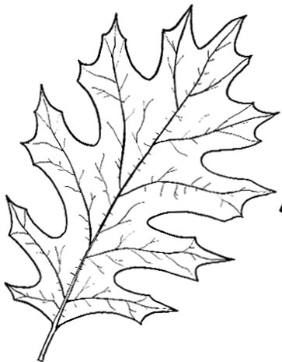
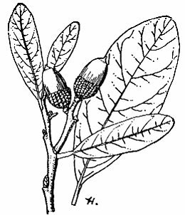
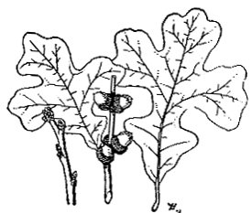
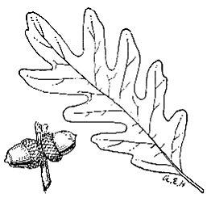
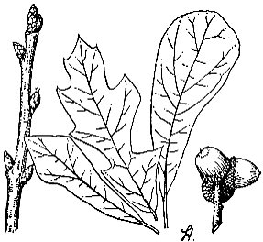
Texas Oak Trees
Group 1
Number of species in Texas – 52+
Primary species are:
Red Oak
Live Oak
White Oak
Post Oak
Water Oak
Black Jack Oak
BlackJack Oak
Shumard Red Oak
Live Oak
Water Oak
White Oak
Post Oak

Slide 8
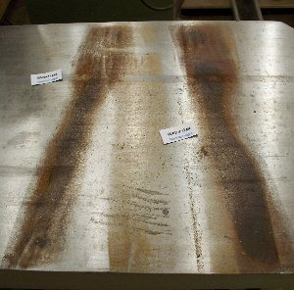
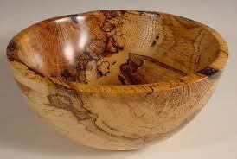
Texas Oak Trees
Oak wood is heavy, strong, hard, tough and durable. Often it is course grained and cracks easily while drying. Can react with iron (particularly when wet) and cause staining and discoloration.
The bark and wood is rich in tannin.
Oak wood is used for:
Construction Lumber and Beams
Watertight barrels
Furniture
Wagons
Implement handles
Interior finish and trim
Flooring
Fuel, firewood
Cross-ties
Tannin damage to cast iron jointer table.
The Color of Oak wood
Red Oak is reddish-brown.
BlackJack Oak has many colors including black, red, yellow, brown, pink and all colors may be in one piece of wood.
White Oak, Water Oak are light brown in color.
Post Oak light to dark brown

Slide 9
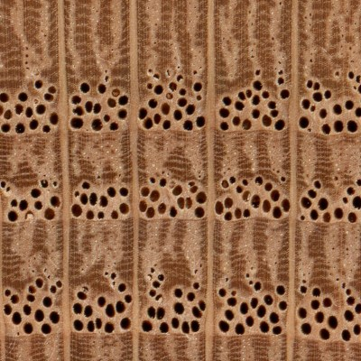
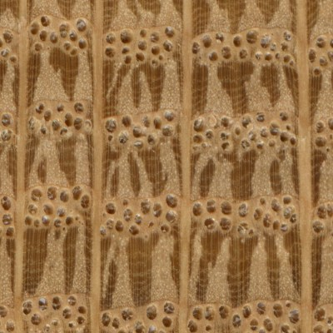
Texas Oak Trees
Red Oak, Water Oak and Blackjack Oak are open grain woods. The pores found in the growth rings on Red Oaks are very open and porous, and should be easily identifiable.
White Oak, and Post Oak have closed grain cells. Their pores are plugged with tyloses, which help make White Oak suitable for water tight vessels, and give it increased resistance to rot and decay. The presence of tyloses is perhaps the best and most reliable way to distinguish the two Oaks.
White Oak End Grain (10x)
Red Oak End Grain (10x)

Slide 10
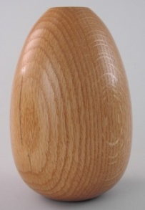
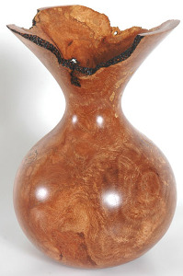
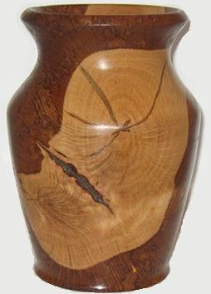
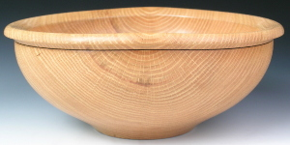
Texas Oak Trees
groups, and which oaks fall into which groups:
While there is one specific wood) that is commonly considered
These are the reasons why you would want to be able to distinguish between the two:
White Oak is much more resistant to rot, and is suitable for water-holding applications, boat building, outdoor furniture, etc. White Oak tends to be more dense
Red Oak should only be used for interior pieces such as cabinets, indoor furniture, etc.
Red Oak is a bit lighter and has a more porous and open grain.
White Oak is usually slightly more expensive than Red Oak.

Slide 11
Texas Oak Trees
groups, and which oaks fall into that is commonly considered
Red Oak Group | White Oak Group
Red Oak (Quercus rubra) Black Oak (Q. velutina) California Black Oak (Q. kelloggii) Cherrybark Oak (Q. pagoda) Laurel Oak (Q. laurifolia) Pin Oak (Q. palustris) Scarlet Oak (Q. coccinea) Shumard Oak (Q. shumardii) Southern Red Oak (Q. falcata) Water Oak (Q. nigra) Willow Oak (Q. phellos) | White Oak (Quercus alba) Bur Oak (Q. macrocarpa) Chestnut Oak (Q. prinus) English Oak (Q. robur) Holm Oak (Q. ilex) Oregon White Oak (Q. garryana) Overcup Oak (Q. lyrata) Post Oak (Q. stellata) Sessile Oak (Q. petraea) Swamp Chestnut Oak (Q. michauxii) Swamp White Oak (Q. bicolor) BlackJack Oak (Quercus marilandica)

Slide 12
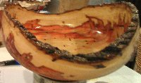
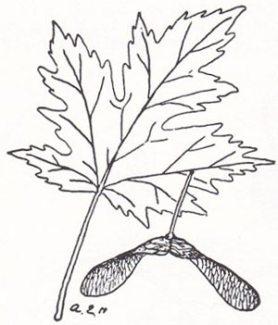
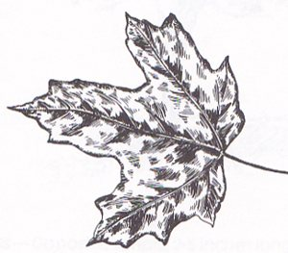
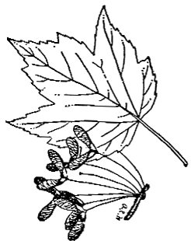
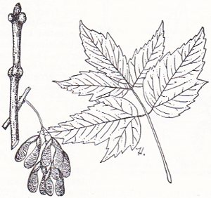
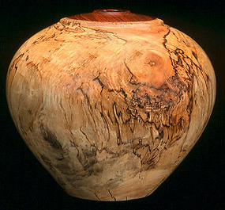
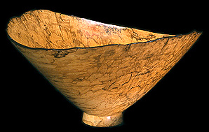
Maple Trees
128 Species world wide, most in Asia
Thirteen species in N. America
Nine species in Texas
Some species are:
Silver Maple (soft Maple)
Red Maple (soft Maple)
Hard or Sugar Maple
Box Elder
Ambrosia Maple
Silver Maple
Sugar or Hard Maple
Red Maple
Box Elder

Slide 13
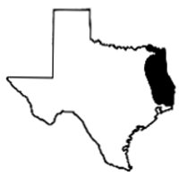
The Soft Maples
Red Maple range
Silver Maple - Acer saccharinum: Unlike most other hardwoods, the sapwood of maple lumber is most commonly used rather than its heartwood. Sapwood color ranges from almost white, to a light golden or reddish brown, while the heartwood is a darker reddish brown. Silver Maple can also be seen with curly or quilted grain patterns.
Grain is generally straight, but may be wavy. Has a fine, even texture. The growth rings tend to be lighter and less distinct in Soft Maples than in Hard Maple.
Silver Maple is so called because of the pale silvery undersides of its leaves. It is readily distinguished from Sugar Maple (i.e., Hard Maple) as the leaves of Silver Maple have deep notches between the lobes, whereas Sugar Maple’s leaves have shallower notches.
Silver Maple is considered to be in the grouping of Soft Maples, and its wood is lighter, softer, and weaker than that of Hard Maple.
The wood is used for Veneer, paper (pulpwood), boxes, crates/pallets, musical instruments, turned objects, and other small specialty wood items.
Red Maple - Acer rubrum: is appropriately named, as its flowers, twigs, seeds, and autumn leaves are all red. Red Maple is common over a very large area of the eastern Untied States, and its wood tends to be slightly heavier, stronger, and harder than other species in the grouping of Soft Maples.

Slide 14
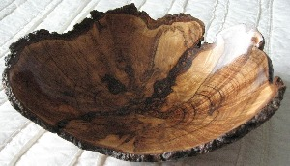
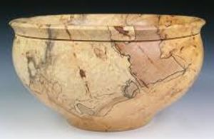
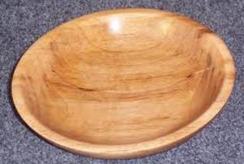
Hard Maple
Hard Maple, Sugar Maple, Rock Maple - Acer saccharum: Birdseye Maple is a figure found most commonly in Hard Maple, though it’s also found less frequently in other species. Hard Maple can also be seen with curly or quilted grain patterns. Grain is generally straight, but may be wavy. Has a fine, even texture.
Fairly easy to work with both hand and machine tools, though slightly more difficult than Soft Maple due to Hard Maple’s higher density. Maple has a tendency to burn when being machined with high-speed cutters such as in a router. Turns, glues, and finishes well, though blotches can occur when staining, and a pre-conditioner, gel stain, or toner may be necessary to get an even color.
In tree form, Hard Maple is usually referred to as Sugar Maple, and is the tree most often tapped for maple syrup. Sugar Maple’s leaves are the shape that most people associate with maple leaves, with vivid autumn coloring ranging from yellow to purplish red.
Hard Maple ought to be considered the king of the Acer genus. Its wood is stronger, stiffer, harder, and denser than all of the other species of Maple commercially available in lumber form.

Slide 15
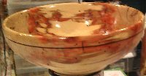
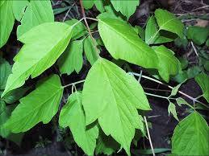
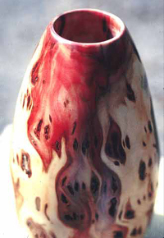
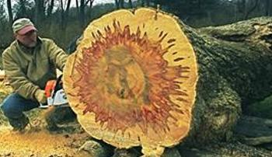
Box Elder Maple Acer negundo A Soft Maple
Odor: Box Elder has a distinct and unpleasant scent when wet, which mostly subsides once dry.
The red stain is produced by the tree’s natural defenses when wounded—it is thought that this compound is meant to inhibit the growth of fungus (Fusarium solani) that commonly colonizes the tree. Much of the reddish coloring becomes a more subdued pink or brown/gray upon drying.

Slide 16
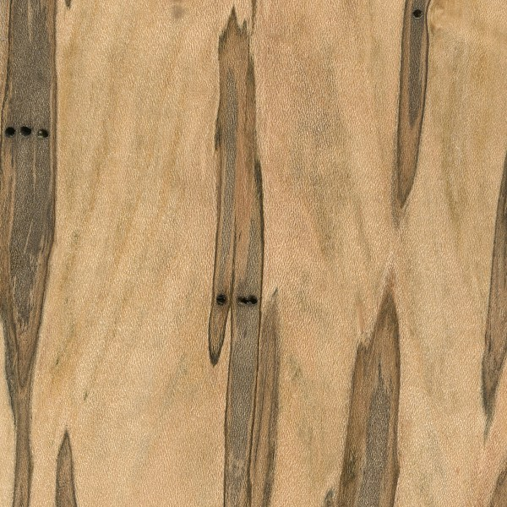
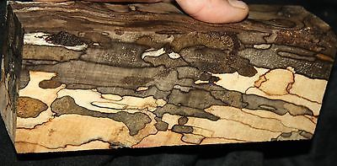
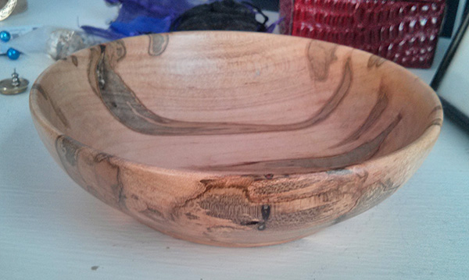
Ambrosia Maple
Much like Spalted Maple and other forms of figured maple, Ambrosia Maple is technically not a specific species of Maple, but rather a general description of any type of Maple that has been infested by ambrosia beetles. The beetles bore into the tree, and with it bring fungus that discolors the wood.
Figured Maples
Ambrosia Maple
Birdseye Maple
Curly Maple
Quilted Maple
Spalted Maple

Slide 17
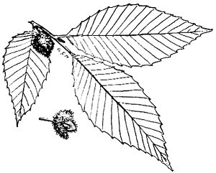
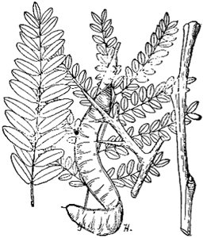
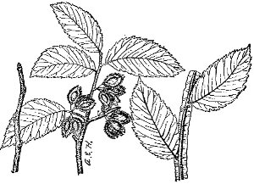
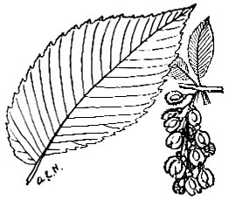
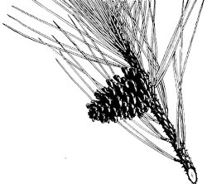
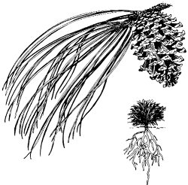
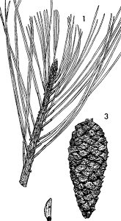
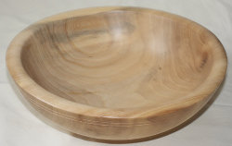
Texas Woods
Number of species in Texas
Elm - 7
Pine - 11
Locust - 4
Beech - 1
American Beech
American Elm
Cedar Elm
Loblolly Pine
Longleaf Pine
Slash Pine
Honey Locust
American Beech
Honey Locust
(Thorn Tree)
Cedar Elm
American Elm
(White Elm)
Loblolly Pine
Longleaf Pine
Slash Pine
Cedar Elm Bowl

Slide 18
Texas Woods
American Elm range
American Elm – Ulmus americana: Considered a Soft Elm. The wood is heavy, hard, strong, tough with an interlocking grain that makes it difficult to split. Soft even grain. The thick sapwood is yellowish with distinct growth rings and the heart wood is light brown with a slight reddish hue. It spalts easily.
The wood is used for hubs of wheels, yokes, saddle trees, veneer for baskets and crates, barrel hoops, and slack cooperage. Is considered one of the best woods for barrel staves. It is often used for the arching or curved parts of furniture.
American Elm
Cedar Elm – Ulmus crassifolia: Considered a Hard Elm and it’s wood is lighter in color, usually creamy white.
Cedar Elm

Slide 19
Texas Woods
Loblolly Pine – Pinus Taeda: is resinous and large-grained. There is marked contrast, as in other yellow pines, between the bands of springwood (pale yellow/ cream) and summerwood (darker reddish orange). The most common pine in East Texas.
The wood has a wide range of uses such as building material, Lumber, beams, plywood, wood pulp, box shooks, barrel staves, basket veneers, pulpwood, hath, mine props, piling, and fuel.
Pine Bowls
The four major species known collectively as
Southern Yellow Pine are:
Shortleaf Pine (Pinus echinata)
Slash Pine (Pinus elliotti)
Longleaf Pine (Pinus palustris)
Loblolly Pine (Pinus taeda)

Slide 20
Texas Woods
Honey Locust – Gleditsia triacanthos: has many desirable qualities: attractive figure and color, hardness and strength, and no odor or taste. It is straight, coarse-grained, and moderately durable in contact with the ground. The long straight, sharp, shiny thorns are a problem during harvesting. Cattle eagerly eat the sweet bean pods. They can contain as much a thirty percent sugar, higher than sugar beets. The sapwood is creamy-white to yellowish and the heartwood is pinkish to red-brown.
The wood is used for fence post, rails, and construction wood. It is also used for crafts, furniture, and sliced into veneer.
Honey Locust Bowl

Slide 21
Texas Woods
American Beech – Fagus grandeifolia: The wood is straight grained, hard, heavy, strong, stiff, and tough, though it will not last long on exposure to weather or in the soil. The sapwood is whitish, with a white to pinkish to reddish-brown heartwood. It looks a lot like Oak but is more even grained. It has conspicuous rays and tiny pores, a straight to interlocked pattern, and a close grain with a fine texture. It spalts easily and beautifully.
Spalted Beech Bowl
The tree is used for lumber, flooring, carpenters’ tools, charcoal, railroad ties, boxes, crates, brush backs, pallets, violin backs, turning, firewood, and novelty wares. It is also used for the curved portion of furniture by steam bending while retaining its strength. It becomes slick with wear and so its perfect for drawer sides and runners. It has no odor or taste so its used for wooden food utensils.

Slide 22
The Texas Hard Woods
Number of species in Texas
Hickory - 10
Pecan - 3
Walnut - 5
Mesquite - 2
Shagbark Hickory
Shagbark Hickory – Carya ovata
Pecan – Carya illinoensis
Black Walnut – Juglans nigra
Honey Mesquite – Prosopis juliflora
Pecan
Black Walnut
Hickory Bowl
Honey Mesquite

Slide 23
The Texas Hard Woods
Shagbark Hickory - Carya ovata: The wood is heavy, hard, extremely tough, and strong. The sapwood is whitish with a creamy to pinkish brownish heartwood. The grain is straight close, and even textured. This wood shrinks considerable when drying but is stable. It causes moderate blunting of cutting edges. Can distort and move during seasoning. Known for its flexibility, strength, shock resistance and resiliency. Also has high bending strength and crushing strength, high stiffness. This outstanding combination of properties makes hickory great for use as striking tools such as hammers and axes. The bark is smooth and firm when young, becoming somewhat darker and breaking into narrow loose plates that are attached near the middle and curve out from the trunk giving it a distinctive shaggy appearance.
Mockernut Hickory – Carya tomentosa: Looks almost identical as Shagbark but has lighter, smoother gray bark and the wood is whiter. Also called White Hickory.
The wood is used in the manufacture of hammers, axe, sledges as tool handles, ladder rungs, wagon wheel spokes, and sports equipment like bats and golf clubs. It is used for furniture, turnings, drumsticks , fishing rods, skis, and cabinetwork . Hickory makes good fuel and is popular for smoking meats. The eastern Indians fermented the tasty nuts into a drink called powcohiccora, which is where the name “hickory” comes from.

Slide 24
The Texas Hard Woods
Pecan - Carya illinoensis: The “State Tree of Texas”. The wood is heavy, hard and some what brittle. Pecan wood has a white to light reddish-brown sapwood and a darker red heartwood. It is not as strong as other hickories. The tight grain is straight, is often mottled or wavy with a medium to coarse texture. Undervalued by many woodworker, this is a fine, attractive wood. Known for its flexibility, strength, shock resistance and resiliency. Also has high steam bending strength and crushing strength and high stiffness. Shrinkage is high when drying. Spalts easily and is the most beautiful of the spalted woods.
Water Hickory – Carya aguatica and Nutmeg Hickory – Carya myristicaeformis are also considered pecans because of there natural cross between Pecan and Hickory.
The wood is used for turnings, furniture, chairs, drumsticks, fuel, wagon stock and softball bats. Also used for flooring and veneer.

Slide 25
The Texas Hard Woods
Black Walnut - Juglans nigra: The wood has a whitish sapwood and the heartwood is a chocolate or purple-brown , which is unique among commercial hardwoods of the United States. The wood is heavy, hard, strong and shock resistant. It is free from warping and checking. It has distinct growth rings, a mild characteristic odor, and is rated one of the finest domestic cabinet woods. Walnut is prized for veneer and furniture construction. It has a good texture and can be polished to a high finish. Walnut has a high tannin content. Walnut has crotches, burls, fiddle back, and stripes and makes a unique and beautiful bowl.
Its durability make it highly prized for turning, carving, furniture and cabinet work. European and some American walnut is prized for gunstocks.

Slide 26
The Texas Hard Woods
Honey Mesquite - Prosopis juliflora: The wood is heavy, hard, and strong with a dark reddish-brown heartwood and a very distinctive yellowish sapwood. Has a distinctive pleasant odor when turned. Mesquite burls are prized for there unique grain when turned. The wood is often crooked with pitch pockets and bark inclusions.
It is much used for smoking meats and because it is durable in the ground for fence posts. Wagon wheels, hubs and spokes where also made from mesquite. Recently it has come into its own for such things as attractive flooring , gunstocks, tables and furniture as well as turned objects. The seedpods were fermented into an alcoholic beverage by Indians.

Slide 27
Other Hard Texas Woods
Number of species in Texas
Ebony - 1
Persimmon - 4
Texas Ebony
Common Persimmon
also called Eastern Persimmon
Texas Ebony
Texas Ebony Vase
Persimmon Bowl
Persimmon

Slide 28
Other Hard Texas Woods
Texas Ebony – Pithecellubium flexicaule: The Heartwood is a dark reddish (sometimes purplish) brown to nearly black. Pale yellow sapwood is clearly demarcated from heartwood. Heartwood ages to almost black. Grain can be irregular or wild. Has a fine, uniform texture with a very good natural luster. Very durable regarding decay resistance. Can be difficult to work on account of its density, but turns superbly, and able to take a very high natural polish.
In addition to Desert Ironwood, Texas Ebony might be considered one of the only “exotic” hardwoods that’s native to the United States.
Though it’s not a true ebony in the Diospyros genus, it’s perhaps the only native wood that’s dark enough to serve as a respectable ebony substitute. (And, like most respectable ebony substitutes such as Katalox or Wenge, it’s also very expensive.)
The wood is used for Knife handles, inlay, fine furniture, turned objects, and other small, specialty wood items.
Texas Ebony range

Slide 29
Other Hard Texas Woods
Common Persimmon - Diospyros virginiana: Also called Eastern Persimmon. Very wide sapwood is a white to pale yellowish-brown. Color tends to darken with age. Very thin heartwood (usually less than 1″ wide) is dark brown to black, similar to ebony. Grain is straight, with a uniform medium-coarse texture. Being that nearly all of Persimmon is sapwood, it is rated as perishable and is susceptible to insect attack.
Overall workability is so-so. Persimmon generally responds well to hand tools, but can be difficult to plane and blunts cutting edges faster than expected. Turns and finishes well.
Persimmon trees are known much more commonly for their fruit, and not their wood. Persimmon is technically related to true ebonies (Diospyros genus), and is therefore sometimes referred to as “white ebony” because of its hardness. Persimmon wood is heavy, hard, and strong for a temperate species. It has excellent shock and wear resistance, but has a very high shrinkage rate, and may experience significant movement in service.
The wood is used for turned objects, golf club heads, veneer, and other small specialty wood items.
Common Persimmon range

Slide 30
Janka Hardness Test
Pounds-force in Newtons

Slide 31
Other Texas Woods
Number of species in Texas
Hackberry – 5
Sweetgum – 1
Ash -----------12
Sycamore----2
Sugarberry Hackberry
Sweetgum
Green Ash
White Ash
American Sycamore
Sycamore
Sweetgum
Sugarberry Hackberry
White Ash
Green Ash
Sycamore Carved Bowl

Slide 32
Other Texas Woods
Sugarberry Hackberry - Celtis laevigata is one of the most common trees in the eastern third of Texas. The wood is soft, weak, with distinct annual rings and is similar to Elm in texture and structure. Decays easily when left exposed to weather. The heartwood is light brown to gray, the wide sapwood is a contrasting light yellow. Susceptible to blue-gray fungal staining if not processed promptly. Grain is usually straight or occasionally slightly interlocked, with a close-grained, very coarse uneven texture. Responds superbly to steam bending. Glues, turns, stains, and finishes well. Can have a mild odor when worked.
In terms of outward appearance, Hackberry bears a close resemblance to ash; anatomically, however, it’s closest to elm, with the pores arranged in wavy tangential bands, which is characteristic of the elms. Hackberry is reputed to among the very best woods for steam bending among hardwoods native to the United States and Canada. The wood is used occasionally for flooring, and furniture, but chiefly for firewood. Also used for boxes/crates, veneer, turned objects, and bent parts

Slide 33
Other Texas Woods
Sweetgum - Liquidambar styraciflua: Sweetgum is one of the most common hardwood trees in the East Texas Piney woods. The wood is moderately heavy, hard, close grained, and not durable on exposure. The sapwood is creamy white with gray to reddish-brown heartwood. This suggest the name red gum and is not present to any appreciable extent in logs under 16 inches in diameter. The grain is irregular, interlocking, but with a very fine uniform texture and takes a satiny finish well. These qualities, plus its availability, size, and quick growth rate, make Sweetgum the leading commercial hardwood species in East Texas. The wood turns, glues, stains and finishes well. Responds moderately well to steam bending. Sweetgums woody thorny fruits or “balls” can be a problem. The vanilla-scented resin of the sap is often made into chewing gum, therefore the name Sweetgum. The wood tends to warp and twist when dried.
The wood is extensively used for flooring, turning, interior finish, cabinet work, plywood, paper pulp, and veneers and for baskets of all kinds.

Slide 34
Other Texas Woods
Ash Wood is heavy, hard, rather strong, brittle, and coarse-grained. Green and White Ash has excellent shock resistance, and along with Hickory, it is one of the most commonly used hardwoods for tool handles in North America—particularly in shovels and hammers where toughness and impact resistance is important.
Green Ash - Fraxinus pennsylvanica: The wood is heavier and somewhat more brittle than White Ash but is generally used for the same purposes.
White Ash - Fraxinus americana: The wood of white ash is extremely valuable because of its toughness and elasticity. The wood is whitish with a light brownish heartwood and distinct growth rings. The wood is heavy and hard with a nice straight grain with makes it easy to split as firewood. The wood is open-grained, with distinctive rows of tiny open pores the show up even when it is painted.
It is preferred for turned objects, small tool handles, athletic equipment, baseball bats, and agricultural implements, and is used extensively for furniture and interior trim. Ash as a cabinet wood and veneer has come into its own. Ash has superb steam bending characteristics. The wood can yellow with age. Indians used the straight branches for arrows and the wood was also good for bows.
Green Ash range
White Ash range

Slide 35
Other Texas Woods
American Sycamore - Platanus occidentalis: Similar to maple, the wood of Sycamore trees is predominantly comprised of the sapwood, with some darker heartwood streaks also found in most boards. The sapwood is white to light tan, while the heartwood is a darker reddish brown. Sycamore also has very distinct ray flecks present on quartersawn surfaces - giving it a freckled appearance—and it is sometimes even called “Lacewood.” Sycamore has a fine and even texture that is very similar to maple. The grain is interlocked. Overall, Sycamore works easily with both hand and machine tools, though the interlocked grain can be troublesome in surfacing and machining operations at times. Sycamore turns, glues, and finishes well. Responds poorly to steam bending. Sycamore lumber is bad about twisting and racking due to moisture changes.
The wood is used for Veneer, plywood, interior trim, pallets/crates, flooring, furniture, particleboard, paper (pulpwood), tool handles, and other turned objects.
Sycamore range

Slide 36
Colored Texas Woods
Number of species in Texas
Walnut - 5
Redcedar - 4
Bois-d’-arc - 1
Mulberry - 4
Black Walnut
Eastern Redcedar
Bois-d’-arc/Osage-orange
Red Mulberry
Black Walnut
Redcedar
Red Cedar Vase
Red Mulberry
Bois-d’-arc/Osage-orange

Slide 37
Colored Texas Woods
Black Walnut - Juglans nigra: It would be hard to overstate Black Walnut’s popularity among woodworkers in the United States. Its cooperative working characteristics, coupled with its rich brown coloration puts the wood in a class by itself among temperate-zone hardwoods. To cap it off, the wood also has good dimensional stability, shock resistance, and strength properties.
The heartwood can range from a lighter pale brown to a dark chocolate brown with darker brown streaks. Color can sometimes have a grey, purple, or reddish cast. Sapwood is pale yellow-gray to nearly white. Figured grain patterns such as curl, crotch, and burl are also seen. The Grain is usually straight, but can be irregular. Has a medium texture and moderate natural luster. Black Walnut is rated as very durable in terms of decay resistance. Black Walnut has a faint but distinctive odor when being worked. Typically easy to work provided the grain is straight and regular. Planer tearout can sometimes be a problem when surfacing pieces with irregular or figured grain. Glues, stains, and finishes well, (though walnut is rarely stained). Responds well to steam bending.
Walnut range

Slide 38
Colored Texas Woods
Black Walnut - is used for Furniture, cabinetry, gunstocks, interior paneling, veneer, turned items, and other small wooden objects and novelties.
Walnut range
Walnut crotch wood

Slide 39
Colored Texas Woods
Eastern Redcedar – Juniperus virginiana: Heartwood tends to be a reddish or violet-brown. Sapwood is a pale yellow color, and can appear throughout the heartwood as streaks and stripes. Has a straight grain, usually with knots present. Has a very fine even texture. Regarded as excellent in resistance to both decay and insect attack. Overall, Aromatic Red Cedar is easy to work, notwithstanding any knots, bark inclusions or irregularities present in the wood. It reportedly has a high silica content, which can dull cutters. Aromatic Red Cedar glues and finishes well, though in many applications, the wood is left unfinished to preserve its aromatic properties. Although Aromatic Red Cedar is included in the cypress family (Cupressaceae) which includes many species of cedar, it’s perhaps more closely related in junipers in the genus Juniperus. In tree form, it is more commonly called Eastern Redcedar, while the wood itself is usually referred to as Aromatic Red Cedar.
Odor: Aromatic Red Cedar has a distinct and tell-tale scent: the wood is commonly used in closets and chests to repel moths and other insects.
Aromatic Red Cedar is frequently used for fence posts in direct ground contact with no pre-treating of the wood. The wood is used for closet and chest linings, carvings, turnings, outdoor furniture, birdhouses, pencils, bows, and small wooden specialty items.
Redcedar range

Slide 40
Colored Texas Woods
Bois-d’-arc/Osage-orange – Maclura pomifera: The Heartwood is golden to bright yellow, which inevitably ages to a darker medium brown with time: primarily due to exposure to ultraviolet light. Grain is straight, with a fine to medium texture. High natural luster. Osage Orange is extremely durable and is considered to be one of the most decay resistant woods in North America.
Working Osage Orange can be difficult due to its hardness and density, though it is reported to have little dulling effect on cutting edges. It turns well, and also takes stains, glues and finishes well. Osage Orange has a relatively low modulus of elasticity compared to its weight and modulus of rupture which helps explain why it is sometimes used for archery bows. It’s sometimes called Bois d’arc, which literally means “bow wood” in French. The wood is also very stable, with little seasonal/environmental movement.
Bois-d’-arc range

Slide 41
Colored Texas Woods
Bois-d’-arc/Osage-orange Continued…..
One helpful characteristic that can help separate it from lookalikes such as Mulberry or Black Locust (besides being heavier) is that Osage Orange contains a water-soluble yellow dye, so putting shavings into water will turn the water yellow.
Osage Orange has been shown in studies to produce more BTUs when burned than any other domestic hardwood, and is accordingly sometimes used as firewood.
The wood is used for Fence posts, dye, archery bows, musical instruments, turnings, firewood and other small specialty wood items.

Slide 42
Colored Texas Woods
Red Mulberry - Morus Microphylla: The Heartwood is a yellow to golden brown, darkening to a medium/reddish brown with age. Sapwood is a pale yellowish white. Grain is straight, with a uniform medium texture. Good natural luster. Rated as very durable and rot resistance with good insect resistance and weathering properties. Responds well to both hand and machine tools. Turns, glues, and finishes well.
Mulberry species are perhaps better known for their edible fruit. The leaves of White Mulberry (Morus alba) (from China) are also the primary food source for the silkworm (Bombyx mori), which is used to produce silk.
Mulberry wood itself looks very similar to Osage Orange, though Mulberry tends to be significantly lighter. Black Locust also bears a close resemblance to Mulberry, and it’s weight is only slightly higher than Mulberry’s. However, the two may be easily separated with a blacklight, as Mulberry is non-fluorescent, while Black Locust is highly fluorescent under a blacklight.
The wood is used for fence posts, furniture, and turned objects.
Red Mulberry range

Slide 43
Fruitwoods and Fine Grain Woods
Number of species in Texas
Cherry - 4
Catalpa - 2
Crepe Myrtle - 0
Holly - 4
Pear - 0
Northern Catalpa
Bradford Pear
Black Cherry
Northern Catalpa
Crepe Myrtle
American Holly
Bradford Pear
Black Cherry
American Holly
Crepe Myrtle or Satinwood
Black Cherry Vase

Slide 44
Fruitwoods and Fine Grain Woods
Black Cherry – Prunus serotina: Heartwood is a light pinkish brown when freshly cut, darkening to a medium reddish brown with time and upon exposure to light. Sapwood is a pale yellowish color. The grain is usually straight and easy to work—with the exception of figured pieces with curly grain patterns. Has a fine, even texture with moderate natural luster. Heartwood is rated as being very durable and resistant to decay.
Cherry is known as being one of the best all-around woods for workability. It is stable, straight-grained, and machines well. The only difficulties typically arise if the wood is being stained, as it can sometimes give blotchy results—using a sanding sealer prior to staining, or using a gel-based stain is recommended. Has a mild, distinctive scent when being worked. Black Cherry develops a rich reddish-brown patina as it ages that’s frequently imitated with wood stains on other hardwoods such as Yellow Poplar (Liriodendron tulipifera). This aging process can be accelerated by exposing the wood to direct sunlight.
The wood is used for cabinetry, fine furniture, flooring, interior millwork, veneer, turned objects, and small specialty wood items.
Black Cherry range

Slide 45
Fruitwoods and Fine Grain Woods
Northern Catalpa – Catalpa speciosa: Heartwood color can range from a neutral grayish tan to a richer golden brown: nearly the entire trunk is composed of heartwood. Narrow sapwood is a pale gray. Overall appearance somewhat resembles Ash. Grain is straight, with an open, coarse texture. Catalpa is rated as being durable regarding decay resistance, and holds up well in direct ground contact.
Generally easy to work with hand and machine tools, though care must be taken during sanding to avoid creating indents and ridges where the lighter latewood areas tend to sand more readily than the earlywood portions. Turns, glues, and finishes well, though pore-filling is necessary to obtain a smooth finished surface. Catalpa has a faint, spicy odor
N. Catalpa’s native range

Slide 46
Fruitwoods and Fine Grain Woods
Catalpa continued…..
The genus gets its name from the Catawba Indian tribe’s name for the tree, (the tribe itself is also named after the tree). Catalpa is a popular ornamental tree, with showy flowers, broad leaves, and large, characteristic bean-like fruit; the latter of which lead some to refer to the trees as the Indian Bean tree, or the Cigar tree.
Catalpa is a somewhat underrated hardwood, not seen too often in lumber form. Unlike most other common carving woods, such as Butternut or Basswood, Catalpa is resistant to decay, and is more suited to outdoor carvings than other domestic species. Additionally, Catalpa has superb stability, with very low shrinkage rates, (though initial drying can be problematic, with cracking a common problem on unsealed pieces).
The soft wood is used for fence posts, utility wood, cabinetry, turning and carving.
N. Catalpa’s native range

Slide 47
Fruitwoods and Fine Grain Woods
Crepe Myrtle – Lagerstroemia indica, Related to Asia Satinwood trees.
Heartwood typically golden to reddish brown, with paler yellow/gray sapwood. Colors tend to darken with age upon exposure to light. Curly grain figure very common in this species, with some pieces exhibiting outstanding curl.
Grain is usually straight, though some pieces have wavy or interlocked grain; texture is moderately coarse and uneven; good natural luster. Rated as moderately durable to durable regarding decay resistance, with intermediate resistance to insect attack.
Generally easy to work, producing good results, though pieces with curly grain (as with any species of figured wood) will be more difficult to plane and machine without tearout. Doesn’t have the blunting effect on cutters that true satinwoods exhibit. Turns, glues, and finishes well—polishes to a high luster.
The wood is used for furniture, boatbuilding, general utility work (within its native range), turned objects, and other small specialty items.

Slide 48
Fruitwoods and Fine Grain Woods
Crepe Myrtle continued….
The common Crepe Myrtle (Lagerstroemia indica) from China and Korea was introduced circa 1790 to Charleston, South Carolina, in the United States by the French botanist André Michaux.
It’s hard to tell if the wood is being selectively imported on account of its figure, or if the tree naturally produces a high percentage of curly figure, but from a wood buyer’s perspective, crepe myrtle is perhaps the curliest wood around. Nearly every piece shows some measure of curly grain, with some pieces having an almost three dimensional look on account of the heavy curl.
Unfortunately, Pyinma or Crepe Myrtle is being widely marketed today as “satinwood”, (or perhaps under slightly less confusing terms, such as “Asian satinwood,” or “Cambodian satinwood.”) Yet with the exception of it’s fantastic figure, Pyinma has little in common with the wood species that have been traditionally called satinwood, (it’s softer, lighter in weight, darker in color, much more porous, and of a coarser texture). But misnomers aside, Pyinma or Crape Myrtle is still a great wood for many fine woodworking projects.
Related species of Pyinma, such as Lagerstroemia indica, are commonly sold as ornamental trees, and are referred to as Crepe Myrtle.

Slide 49
Fruitwoods and Fine Grain Woods
Crepe Myrtle continued….
West Indian Satinwood (Zanthoxylum flavom) A genuine Satinwood . Average Dried Weight: 56 lbs./ft3. Often called: Jamaican Satinwood, San Domingo Satinwood.
East Indian Satinwood (Chloroxylon swietenia) A genuine Satinwood . Average Dried Weight: 61 lbs./ft3. Often called: Ceylon Satinwood.
Pyinma (Lagerstroemia species) Average Dried Weight: 44 lbs./ft3. The same family as Crape Myrtle (Lagerstroemia Indica). Often called: Asian or /Cambodian Satinwood
Yellowheart (Euxylophora paraensis) Average Dried Weight: 56 lbs./ft3. Often called: Brazilian Satinwood or called by its Portuguese name Pau Amarello, meaning “yellow wood.”
Also known as Satinwoods are:
Movingui (Distemonanthus Benthamianus), Avodire (Turraeanthus africanus), Afrormosia (Pericopsis elata), Obeche (Triplochiton scleroxylon). All are often called Nigerian or African Satinwood.

Slide 50
Fruitwoods and Fine Grain Woods
American Holly – Ilex opaca: Ideal lumber has a very uniform, pale white color with virtually no visible grain pattern. Knots are common, which can reduce the usable area of the wood. Can develop a bluish/gray fungal stain if not dried rapidly after cutting. Holly is usually cut during the winter and kiln dried shortly thereafter to preserve the white color of the wood.
Grain is interlocked and irregular. Medium to fine uniform texture with moderate natural luster. Rated as non-durable or perishable, and susceptible to insect attack.
Can be difficult to work on account of the numerous knots and interlocked grain. Glues, stains, and finishes well, and is sometimes stained black as a substitute for Ebony. Turns well on the lathe. Holly is typically used only for ornamental and decorative purposes. It has a fairly large shrinkage rate, with a lot of seasonal movement in service, and its strength properties are mediocre for a hardwood.
Its used for inlays, furniture, piano keys (dyed black), broom and brush handles, turned objects, and other small novelty items.
American Holly range

Slide 51
Fruitwoods and Fine Grain Woods
Bradford Pear – Pyrus calleryana ‘Bradford’: A fruitless pear tree raised in local landscapes. Pyrus calleryana, the Callery pear, is a species of pear native to China and Vietnam, in the family Rosaceae. Bradford Pear is a cultivar. The heartwood is a pale pink or light reddish brown. Sapwood is slightly paler but is not usually distinct from heartwood. Pear is sometimes steamed to deepen the pink coloration. Pear is also occasionally dyed black and used as a substitute for ebony.
Grain is usually straight, with a very fine uniform texture. It’s been said that Pear is used in Europe much in the same way that Black Cherry is used in the United States: as a popular and high-quality domestic hardwood.
Pear wood (of any species) is among the finest-textured of all fruitwoods. It is prized for making woodwind instruments, and pear veneer is used in fine furniture.^{[7]} Pear wood also is one of the woods preferred for preparing woodcuts for printing, whether by the end-grained technique for small works, or side-grained for larger works.
Veneer, architectural millwork, marquetry, inlay, carving, musical instruments, furniture, cabinetry, and turned objects.

Slide 52
More Texas Woods
Number of species in Texas
Magnolia - 3
Cottonwood - 4
Cypress - 2
Poplar - 1
Southern Magnolia
Southern Magnolia
Eastern Cottonwood
Bald Cypress
Yellow Poplar
Eastern Cottonwood
Southern Magnolia vase
Bald Cypress
Bald Cypress vase
Yellow Poplar

Slide 53
More Texas Woods
Southern Magnolia – Magnolia grandiflora: The very wide sapwood is a creamy white to grayish color. Comparatively narrow heartwood color ranges from a medium to dark brown, sometimes with green, purple or black streaks.
Grain is straight, with a medium to fine uniform texture. Moderate natural luster. Rated as non-durable to perishable regarding decay resistance, and also susceptible to insect attack.
Generally easy to work with both hand and machine tools. Turns, glues, stains, and finishes well. Southern Magnolia is the hardest and heaviest of the three primary magnolia species that are commercially harvested in the United States.
The wood is used for veneer, plywood, interior trim, upholstered furniture frames, turning and general utility wood.
Southern Magnolia range

Slide 54
More Texas Woods
Cottonwood – Populus deitoides: The heartwood tends to be a light brown. Sapwood is a pale yellow to nearly white, and isn’t clearly demarcated, tending to gradually blend into the heartwood. Grain is generally straight to slightly irregular or interlocked. Uniform medium texture with low natural luster. Rated as non-durable, and also susceptible to insect attack.
Easy to work with hand and machine tools, though sharp cutters are necessary when planing to avoid fuzzy surfaces, subsequent fine-sanding may be necessary to obtain a smooth surface. Responds poorly to steam bending. Does not split easily, and has poor nail holding capability. Wood has a tendency to warp and distort during drying. Glues and finishes well. Has a sour odor when green, which disappears once the wood is dry. So named for its cotton-like strands that accompany the tree’s seeds in the spring. It is sometimes called the Pioneer of the Prairie; pioneers on the Oregon Trail would look for such trees, as their shade and firewood was a welcome respite, and their presence usually meant that water was nearby.
The wood is used for Boxes/crates, veneer, plywood, and various utility purposes.
Eastern Cottonwood range

Slide 55
More Texas Woods
Bald Cypress – Taxodium distichum: Color tends to be a light, yellowish brown. Sapwood is nearly white. Some boards can have scattered pockets of darker wood that have been attacked by fungi, which is sometimes called pecky cypress.
Straight grain and medium texture to coarse texture. Raw, unfinished wood surfaces have a greasy feel. Old-growth Cypress is rated as being durable to very durable in regards to decay resistance, while wood from younger trees is only rated as moderately durable.
Sharp cutters and light passes are recommended when working with Cypress to avoid tearout. Also, the wood has been reported by some sources to have a moderate dulling effect on cutting edges. Cypress has good gluing, nailing, finishing, and paint-holding properties. Cypress has a distinct, somewhat sour odor while being worked.

Slide 56
More Texas Woods
Bald Cypress continued….
Bald Cypress is named because the trees are deciduous (unlike most conifers), and have the peculiar trait of dropping all their needle-like leaves each the winter.
The trees also develop unique aerial roots that protrude above the ground (or water) and are especially seen on trees growing in swamps. These structures are known as knees, and are sometimes harvested on a small scale and sold for woodcarving purposes.
Although not technically a Cypress in the strictest sense (Cupressus genus), Bald Cypress is in the Cupressaceæ family, which includes many decay resistant woods including cedars, and the wood is a popular choice in exterior construction applications where decay resistance is needed.
The wood is used for exterior construction, docks, boatbuilding, interior trim, and veneer.

Slide 57
More Texas Woods
Yellow Poplar – Liriodendron tulipifera: The heartwood is light cream to yellowish brown, with occasional streaks of gray or green. Sapwood is pale yellow to white, not always clearly demarcated from the heartwood. Can also be seen in mineral stained colors ranging from dark purple to red, green, or yellow, sometimes referred to as Rainbow Poplar. Colors tend to darken upon exposure to light.
Poplar typically has a straight, uniform grain, with a medium texture. Low natural luster. Heartwood is rated as being moderately durable to non-durable; susceptible to insect attack. Very easy to work in almost all regards, one of Poplar’s only downsides is its softness. Due to its low density, Poplar can sometimes leave fuzzy surfaces and edges: especially during shaping or sanding. Sanding to finer grits of sandpaper may be necessary to obtain a smooth surface. Poplar is one of the most common utility hardwoods in the United States. Though the wood is commonly referred to simply as “Poplar,” it is technically not in the Populus genus itself, (the genus also includes many species of Cottonwood and Aspen), but is instead in the Liriodendron genus, which is Latin for “lily tree.” The flowers of this tree look similar to tulips, hence the common alternate name: Tulip Poplar.

Slide 58
Last of the Texas Woods
Yaupon Holly – Ilex vomitoria
Shining Sumac – Rhus copallina
Western Soapberry (Chinaberry)
Sapindus drummondii
Eastern Redbud Cercis canadensis
Black Willow Salix nigra

Slide 59
Spalted Wood
Woods with a tendency to Spalt
Ash, Beech, Cottonwood, Elms, Hackberry, Hickory, Magnolia, Maples, Oaks, Pecan, Pines, Poplar, Sweetgum, Yellow Poplar and others.

Slide 60
References for researching wood
Books:
Forest Trees of Texas, Texas Forest Service, Bulletin 20, 1963
Texas Trees, a friendly guide, Cox & Leslie, 1988
Trees of East Texas, Vines, 1977
Wood, Identifying and using, Meier, 2016
The Real Wood Bible, Gibbs, 2012
Woodworker’s Guide to Wood, Peters, 2000
Understanding Wood, Hoadley, 2000
Internet:
The Wood Database, www.wood-database.com/
If I can help you in the future with a wood question, contact me:
George Freeman
Quinlan, Texas
H- 903-356-0856
C- 214-334-4035
Use Goggle’s search engine to look up wood facts or images of objects you may want to turn. Here are some suggested searches:
Goggle/ images/ Elm bowl for instance or Mesquite vases.
Spalted bowls, carved wood.
To look at the color and texture of wood, search for: Goggle/images/Silver Maple wood or lumber

