Slide 1
Wood Allergies and Toxicity
John Blattman MD

Slide 2
The majority of wood species have been reported to cause some level of allergic irritation or reaction in sensitive individuals

Slide 3
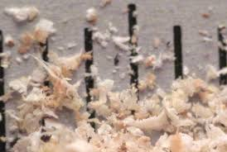
Irritants (Most Common)
Includes dust and small particles of wood from wood turning, sanding and cutting with all saws
Can cause irritation of the skin and eyes with itching and redness
Can cause systemic irritation of the lungs with coughing, sneezing and even asthma like systems

Slide 4
Sensitizers
Substances that sensitize the body causing symptoms of allergic reaction from repeated exposure
First exposure introduces the antigen (or allergen) to which the body responds by producing antibodies
Each additional exposure to the sensitizer produces a more severe reaction

Slide 5
Toxins
Very few woods are actually toxic in and of themselves
Majority are allergenic to susceptible individuals
As far back as 77AD the Romans thought the yew was toxic

Slide 6
Carcinogens
Chronic exposure to any dust of micro small particles, usually in commercial or industrial work, can cause cancer of the respiratory system, i.e. nasal pharyngeal passages and lungs
The importance of dust collection systems can not be over emphasized to reduce the chance of respiratory problems and cancer

Slide 7
Suggestions
If you are a person that is sensitive to a specific wood, it is like being allergic to peanuts, probably best for you not to use that particular wood
By wearing protective clothing, ventilation masks, ventilation hood, etc. you could decrease your risk of a reaction
If you are one of the unlucky ones, Don’t eat the Peanuts!

