Slide 1
Harvesting and Working Green Wood
By George Freeman

Slide 2
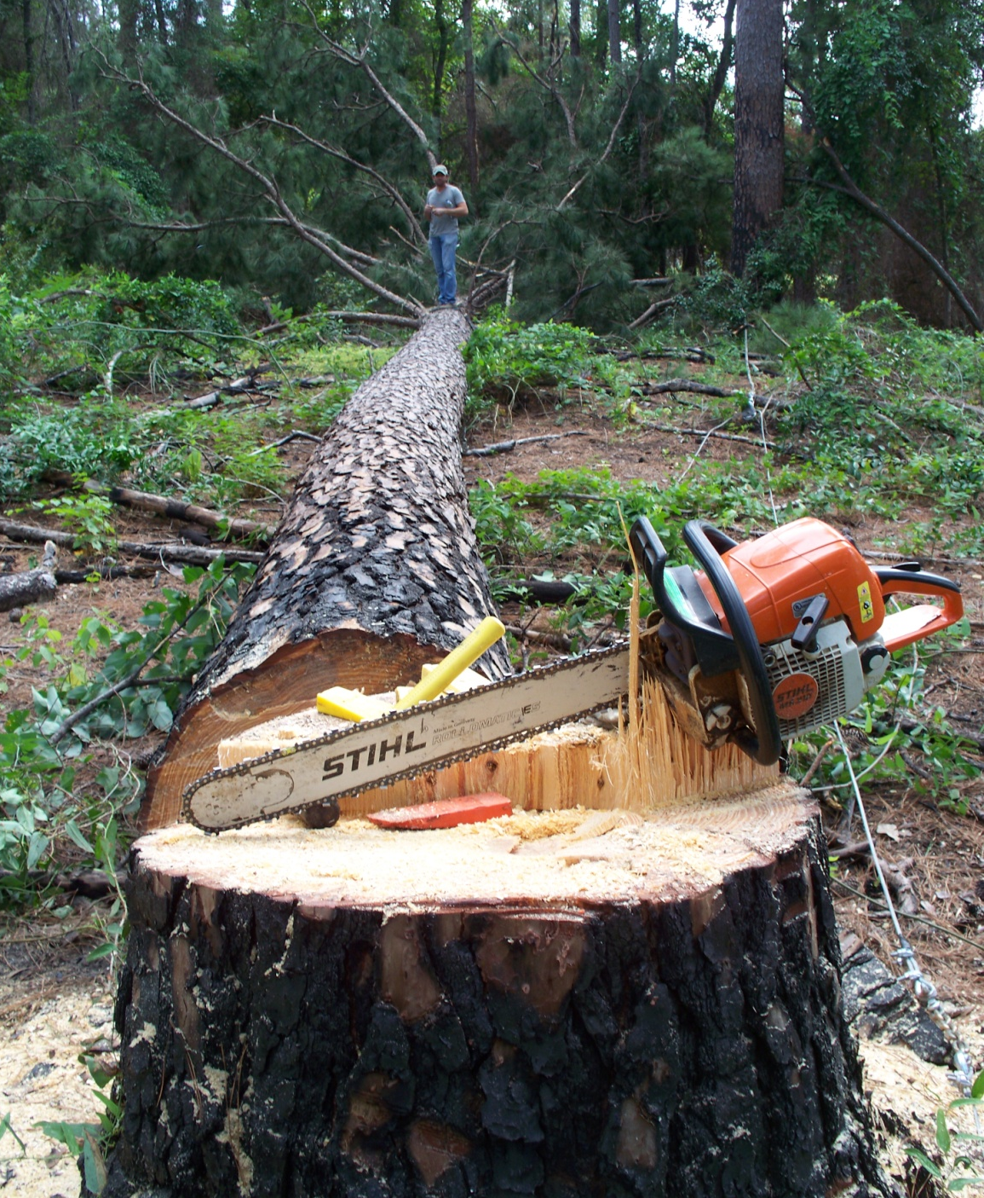
Four ways to obtain green wood for turning:
Cut down a tree.

Slide 3
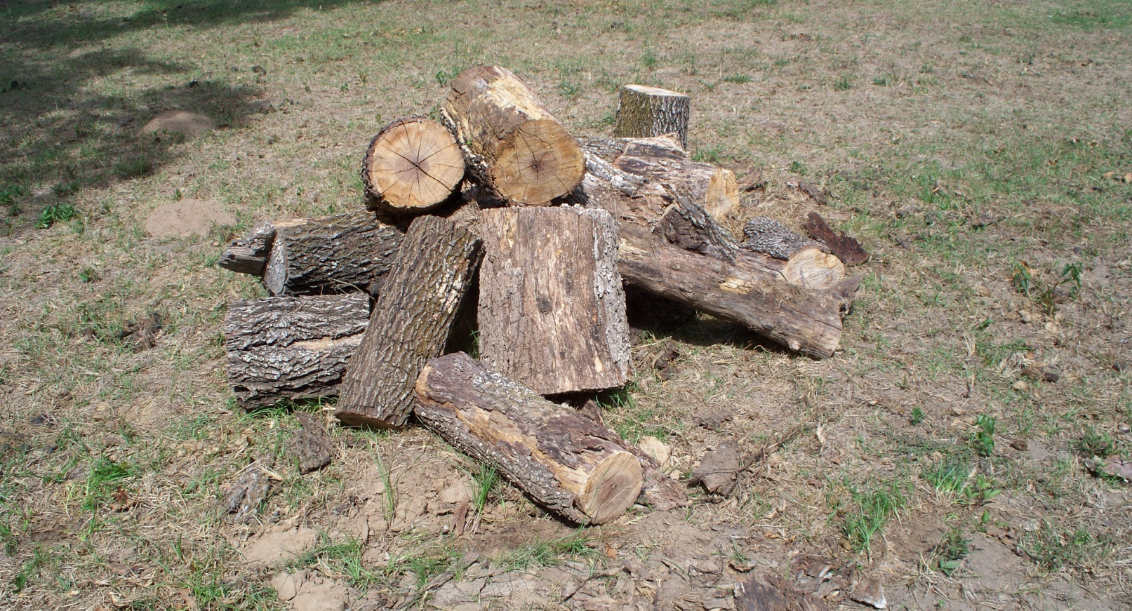
Four ways to obtain green wood for turning:
Find trees already cut down by other people.

Slide 4
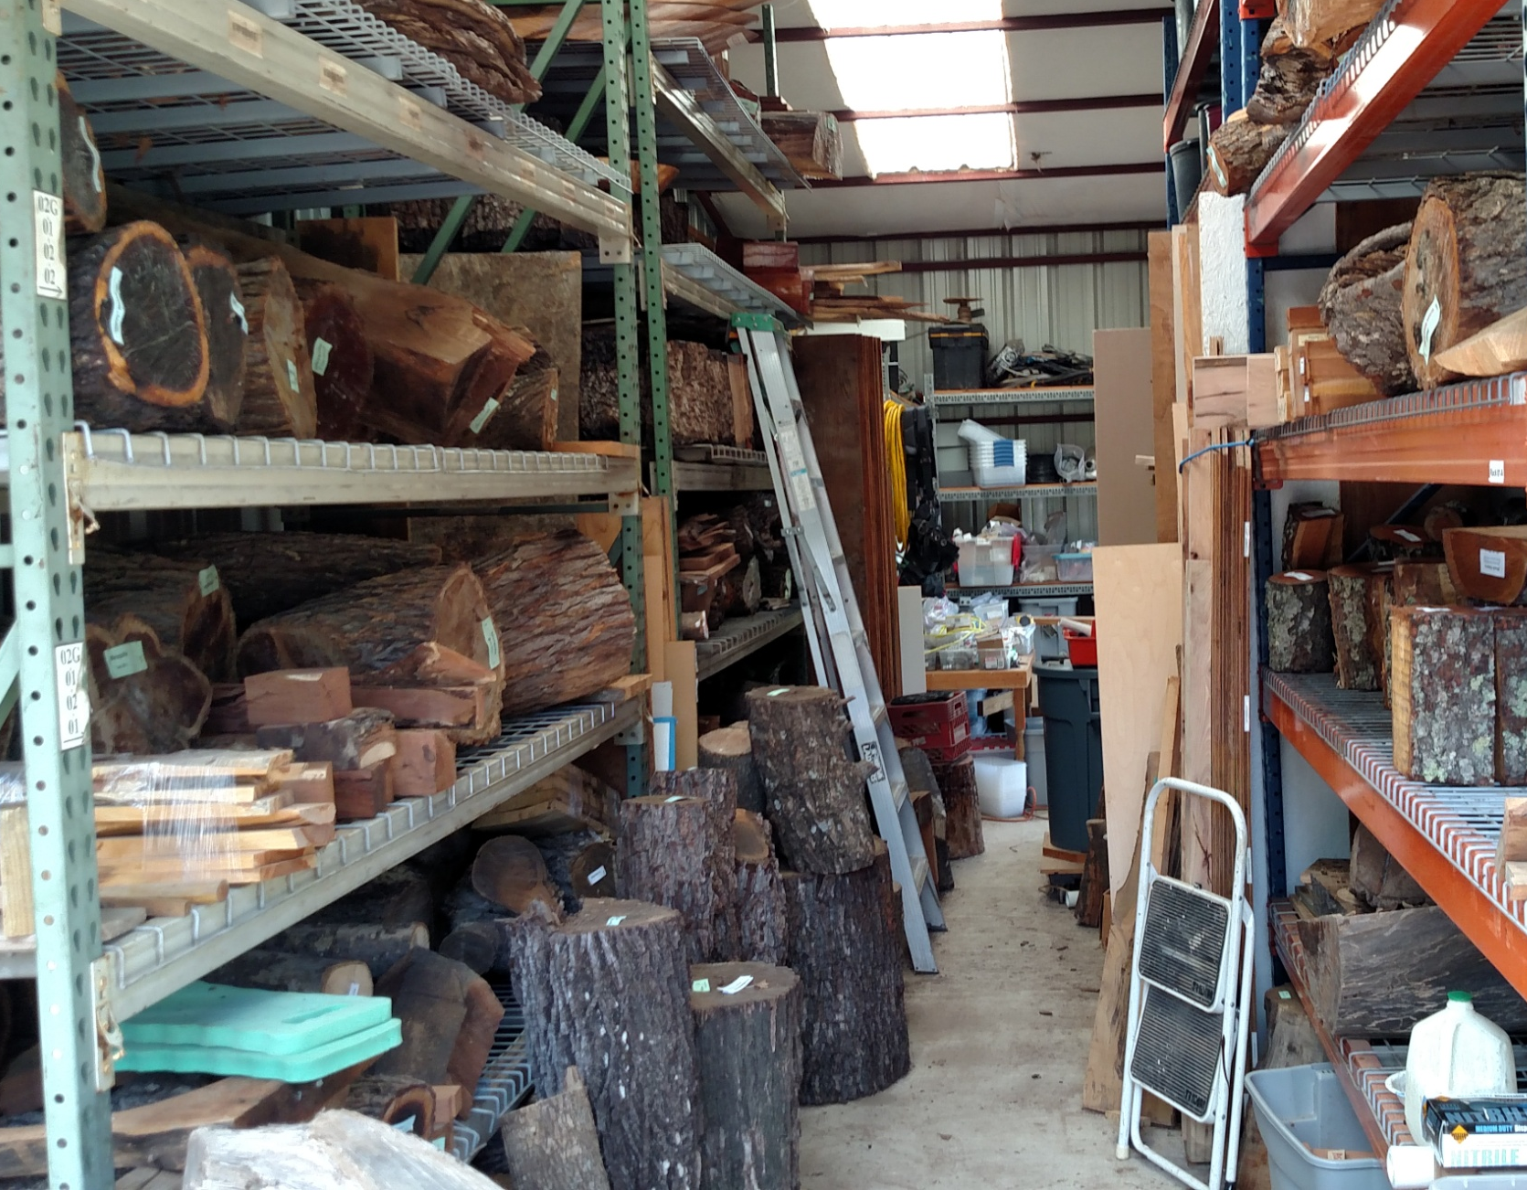
Four ways to obtain green wood for turning:
Have a friend give you green wood they have obtained.

Slide 5
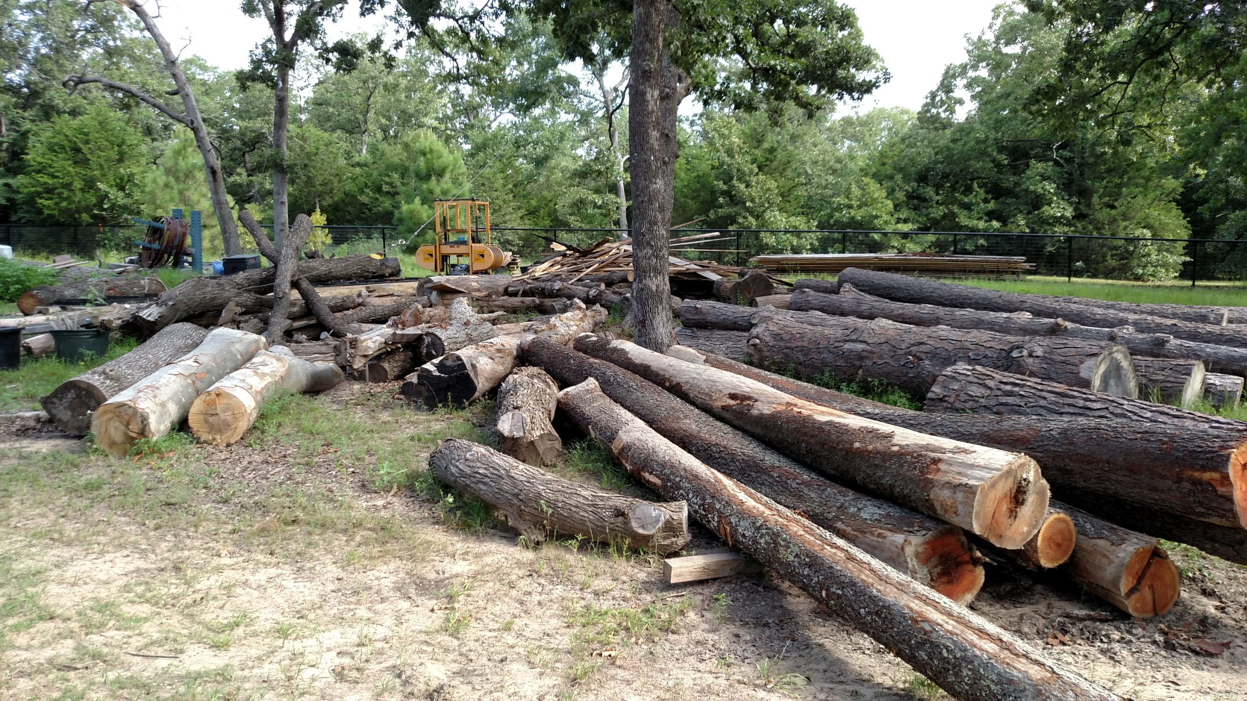
Four ways to obtain green wood for turning:
Hang around someone with a sawmill .

Slide 6
Things to consider about trees
100 foot tall pine tree.
38 inch diameter trunk
2000 board feet of lumber.
20,000 pounds of wet wood.

Slide 7
Doyle volume chart
Results in board feet of lumber
Log length |  | Diameter of log, small end, inside bark (inches) * Results are in board feet per tree (bf)
 |  | 6 | 8 | 10 | 12 | 14 | 16 | 18 | 20 | 22 | 24 | 26 | 28 | 30 | 32 | 34 | 36 | 38 | 40
6 | feet | 2 | 6 | 14 | 24 | 38 | 54 | 74 | 96 | 122 | 150 | 165 | 198 | 234 | 273 | 315 | 360 | 408 | 459
8 | feet | 2 | 8 | 18 | 32 | 50 | 72 | 98 | 128 | 162 | 200 | 221 | 265 | 313 | 365 | 421 | 481 | 545 | 613
10 | feet | 3 | 10 | 23 | 40 | 63 | 90 | 123 | 160 | 203 | 250 | 276 | 331 | 391 | 456 | 526 | 601 | 681 | 766
12 | feet | 3 | 12 | 27 | 48 | 75 | 108 | 147 | 192 | 243 | 300 | 331 | 397 | 469 | 547 | 631 | 721 | 817 | 919
14 | feet | 4 | 14 | 32 | 56 | 88 | 126 | 172 | 224 | 284 | 350 | 386 | 463 | 547 | 638 | 736 | 841 | 953 | 1,072
16 | feet | 4 | 16 | 36 | 64 | 100 | 144 | 196 | 256 | 324 | 400 | 441 | 529 | 625 | 729 | 841 | 961 | 1,089 | 1,225
18 | feet | 5 | 18 | 41 | 72 | 113 | 162 | 221 | 288 | 365 | 450 | 496 | 595 | 703 | 820 | 946 | 1,081 | 1,225 | 1,378
20 | feet | 5 | 20 | 45 | 80 | 125 | 180 | 245 | 320 | 405 | 500 | 551 | 661 | 781 | 911 | 1,051 | 1,201 | 1,361 | 1,531
22 | feet | 6 | 22 | 50 | 88 | 138 | 198 | 270 | 352 | 446 | 550 | 606 | 727 | 859 | 1,002 | 1,156 | 1,321 | 1,497 | 1,684
24 | feet | 6 | 24 | 54 | 96 | 150 | 216 | 294 | 384 | 486 | 600 | 662 | 794 | 938 | 1,094 | 1,262 | 1,442 | 1,634 | 1,838
26 | feet | 7 | 26 | 59 | 104 | 163 | 234 | 319 | 416 | 527 | 650 | 717 | 860 | 1,016 | 1,185 | 1,367 | 1,562 | 1,770 | 1,991
28 | feet | 7 | 28 | 63 | 112 | 175 | 252 | 343 | 448 | 567 | 700 | 772 | 926 | 1,094 | 1,276 | 1,472 | 1,682 | 1,906 | 2,144
30 | feet | 8 | 30 | 68 | 120 | 188 | 270 | 368 | 480 | 608 | 750 | 827 | 992 | 1,172 | 1,367 | 1,577 | 1,802 | 2,042 | 2,297
32 | feet | 8 | 32 | 72 | 128 | 200 | 288 | 392 | 512 | 648 | 800 | 882 | 1,058 | 1,250 | 1,458 | 1,682 | 1,922 | 2,178 | 2,450
34 | feet | 9 | 34 | 77 | 136 | 213 | 306 | 417 | 544 | 689 | 850 | 937 | 1,124 | 1,328 | 1,549 | 1,787 | 2,042 | 2,314 | 2,603
36 | feet | 9 | 36 | 81 | 144 | 225 | 324 | 441 | 576 | 729 | 900 | 992 | 1,190 | 1,406 | 1,640 | 1,892 | 2,162 | 2,450 | 2,756
38 | feet | 10 | 38 | 86 | 152 | 238 | 342 | 466 | 608 | 770 | 950 | 1,047 | 1,256 | 1,484 | 1,731 | 1,997 | 2,282 | 2,586 | 2,909
40 | feet | 10 | 40 | 90 | 160 | 250 | 360 | 490 | 640 | 810 | 1,000 | 1,103 | 1,323 | 1,563 | 1,823 | 2,103 | 2,403 | 2,723 | 3,063
42 | feet | 11 | 42 | 95 | 168 | 263 | 378 | 515 | 672 | 851 | 1,050 | 1,158 | 1,389 | 1,641 | 1,914 | 2,208 | 2,523 | 2,859 | 3,216
44 | feet | 11 | 44 | 99 | 176 | 275 | 396 | 539 | 704 | 891 | 1,100 | 1,213 | 1,455 | 1,719 | 2,005 | 2,313 | 2,643 | 2,995 | 3,369
46 | feet | 12 | 46 | 104 | 184 | 288 | 414 | 564 | 736 | 932 | 1,150 | 1,268 | 1,521 | 1,797 | 2,096 | 2,418 | 2,763 | 3,131 | 3,522
48 | feet | 12 | 48 | 108 | 192 | 300 | 432 | 588 | 768 | 972 | 1,200 | 1,323 | 1,587 | 1,875 | 2,187 | 2,523 | 2,883 | 3,267 | 3,675
50 | feet | 13 | 50 | 113 | 200 | 313 | 450 | 613 | 800 | 1,013 | 1,250 | 1,378 | 1,653 | 1,953 | 2,278 | 2,628 | 3,003 | 3,403 | 3,828
20 ft. tree/ 24 inch diameter at small end = 500 board feet of lumber

Slide 8
Weight Chart based on Doyle Chart
Doyle Log Weight - Hardwoods |  | Table in pounds (lbs.) per log
Log length |  | Diameter of log, small end, inside bark (inches)
 |  | 6 | 8 | 10 | 12 | 14 | 16 | 18 | 20 | 22 | 24 | 26 | 28 | 30 | 32 | 34 | 36 | 38 | 40
6 | feet | 160 | 200 | 260 | 340 | 420 | 560 | 700 | 840 | 1,040 | 1,260 | 1,380 | 1,500 | 1,620 | 1,740 | 1,860 | 1,980 | 2,100 | 2,220
8 | feet | 200 | 260 | 340 | 460 | 600 | 780 | 980 | 1,200 | 1,460 | 1,760 | 1,920 | 2,080 | 2,240 | 2,400 | 2,560 | 2,720 | 2,880 | 3,040
10 | feet | 280 | 320 | 440 | 580 | 780 | 1,000 | 1,260 | 1,560 | 1,880 | 2,260 | 2,460 | 2,660 | 2,860 | 3,060 | 3,260 | 3,460 | 3,660 | 3,860
12 | feet | 320 | 360 | 520 | 720 | 960 | 1,220 | 1,540 | 1,900 | 2,320 | 2,760 | 3,000 | 3,240 | 3,480 | 3,720 | 3,960 | 4,200 | 4,440 | 4,680
14 | feet | 360 | 420 | 600 | 840 | 1,120 | 1,460 | 1,820 | 2,260 | 2,740 | 3,260 | 3,540 | 3,820 | 4,100 | 4,380 | 4,660 | 4,940 | 5,220 | 5,500
16 | feet | 420 | 480 | 700 | 960 | 1,300 | 1,680 | 2,120 | 2,600 | 3,160 | 3,760 | 4,060 | 4,360 | 4,660 | 4,960 | 5,260 | 5,560 | 5,860 | 6,160
18 | feet | 480 | 540 | 800 | 1,080 | 1,480 | 1,900 | 2,420 | 2,940 | 3,580 | 4,260 | 4,560 | 4,860 | 5,160 | 5,460 | 5,760 | 6,060 | 6,360 | 6,660
20 | feet | 540 | 600 | 900 | 1,200 | 1,660 | 2,120 | 2,720 | 3,280 | 4,000 | 4,760 | 5,060 | 5,360 | 5,660 | 5,960 | 6,260 | 6,560 | 6,860 | 7,160
22 | feet | 600 | 660 | 1,000 | 1,320 | 1,840 | 2,340 | 3,020 | 3,620 | 4,420 | 5,260 | 5,560 | 5,860 | 6,160 | 6,460 | 6,760 | 7,060 | 7,360 | 7,660
24 | feet | 660 | 720 | 1,100 | 1,440 | 2,020 | 2,560 | 3,320 | 3,960 | 4,840 | 5,760 | 6,060 | 6,360 | 6,660 | 6,960 | 7,260 | 7,560 | 7,860 | 8,160
26 | feet | 720 | 780 | 1,200 | 1,560 | 2,200 | 2,780 | 3,620 | 4,300 | 5,260 | 6,260 | 6,560 | 6,860 | 7,160 | 7,460 | 7,760 | 8,060 | 8,360 | 8,660
28 | feet | 780 | 840 | 1,300 | 1,680 | 2,380 | 3,000 | 3,920 | 4,640 | 5,680 | 6,760 | 7,060 | 7,360 | 7,660 | 7,960 | 8,260 | 8,560 | 8,860 | 9,160
30 | feet | 840 | 900 | 1,400 | 1,800 | 2,560 | 3,220 | 4,220 | 4,980 | 6,100 | 7,260 | 7,560 | 7,860 | 8,160 | 8,460 | 8,760 | 9,060 | 9,360 | 9,660
32 | feet | 900 | 960 | 1,500 | 1,920 | 2,740 | 3,440 | 4,520 | 5,320 | 6,520 | 7,760 | 8,060 | 8,360 | 8,660 | 8,960 | 9,260 | 9,560 | 9,860 | 10,160
34 | feet | 960 | 1,020 | 1,600 | 2,040 | 2,920 | 3,660 | 4,820 | 5,660 | 6,940 | 8,260 | 8,560 | 8,860 | 9,160 | 9,460 | 9,760 | 10,060 | 10,360 | 10,660
36 | feet | 1,020 | 1,080 | 1,700 | 2,160 | 3,100 | 3,880 | 5,120 | 6,000 | 7,360 | 8,760 | 9,060 | 9,360 | 9,660 | 9,960 | 10,260 | 10,560 | 10,860 | 11,160
38 | feet | 1,080 | 1,140 | 1,800 | 2,280 | 3,280 | 4,100 | 5,420 | 6,340 | 7,780 | 9,260 | 9,560 | 9,860 | 10,160 | 10,460 | 10,760 | 11,060 | 11,360 | 11,660
40 | feet | 1,140 | 1,200 | 1,900 | 2,400 | 3,460 | 4,320 | 5,720 | 6,680 | 8,200 | 9,760 | 10,060 | 10,360 | 10,660 | 10,960 | 11,260 | 11,560 | 11,860 | 12,160
42 | feet | 1,200 | 1,260 | 2,000 | 2,520 | 3,640 | 4,540 | 6,020 | 7,020 | 8,620 | 10,260 | 10,560 | 10,860 | 11,160 | 11,460 | 11,760 | 12,060 | 12,360 | 12,660
44 | feet | 1,260 | 1,320 | 2,100 | 2,640 | 3,820 | 4,760 | 6,320 | 7,360 | 9,040 | 10,760 | 11,060 | 11,360 | 11,660 | 11,960 | 12,260 | 12,560 | 12,860 | 13,160
46 | feet | 1,320 | 1,380 | 2,200 | 2,760 | 4,000 | 4,980 | 6,620 | 7,700 | 9,460 | 11,260 | 11,560 | 11,860 | 12,160 | 12,460 | 12,760 | 13,060 | 13,360 | 13,660
48 | feet | 1,380 | 1,440 | 2,300 | 2,880 | 4,180 | 5,200 | 6,920 | 8,040 | 9,880 | 11,760 | 12,060 | 12,360 | 12,660 | 12,960 | 13,260 | 13,560 | 13,860 | 14,160
50 | feet | 1,440 | 1,500 | 2,400 | 3,000 | 4,360 | 5,420 | 7,220 | 8,380 | 10,300 | 12,260 | 12,560 | 12,860 | 13,160 | 13,460 | 13,760 | 14,060 | 14,360 | 14,660
20 ft. tree/ 24 inch diameter at small end = 4,760 lb. of wood

Slide 9
Weight of Wood
Wood Species | Fresh Green Wood | Air dried Seasoned Wood | Percentage of loss
 | Density (lb/cf | Density (lb/cf | %
Mesquite | 45 | 43 | 4%
Cedar, Eastern Red | 37 | 33 | 11%
Osage orange | 64 | 57 | 11%
Beech, American | 54 | 45 | 17%
Cherry, black | 45 | 35 | 22%
Honey locust | 58 | 45 | 22%
Pine, Southern Yellow | 53 | 41 | 23%
Ash, Green | 53 | 40 | 25%
Oak, white | 63 | 47 | 25%
Mulberry | 59 | 44 | 25%
Maple, silver | 45 | 33 | 27%
Hickory | 62 | 45 | 27%
Pecan | 62 | 45 | 27%
Hackberry | 51 | 37 | 27%
Maple, Sugar | 59 | 42 | 29%
Post oak | 64 | 45 | 30%
Oak, Red | 61 | 42 | 31%
Walnut, black | 58 | 38 | 34%
Elm, American | 54 | 35 | 35%
Cypress, Southern | 51 | 32 | 37%
Redwood, American | 50 | 28 | 44%
Sycamore | 63 | 34 | 46%

Slide 10
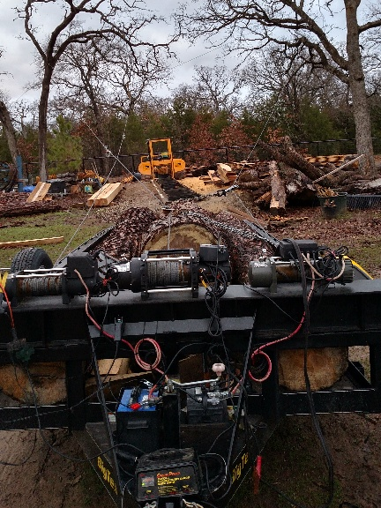
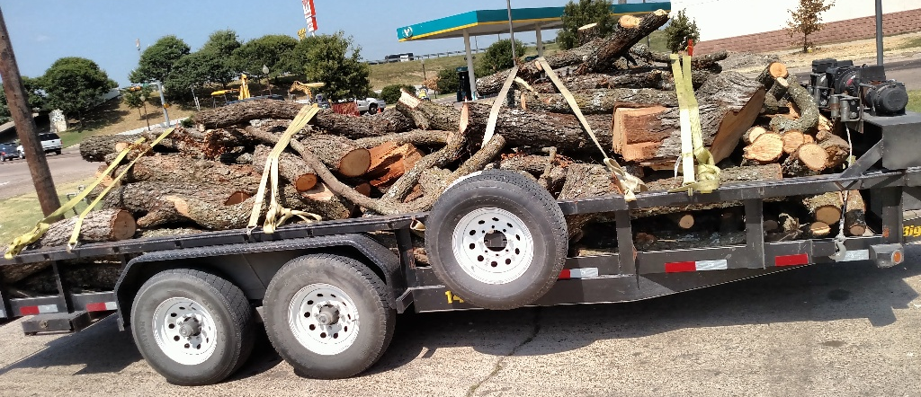
Transporting turning wood

Slide 11
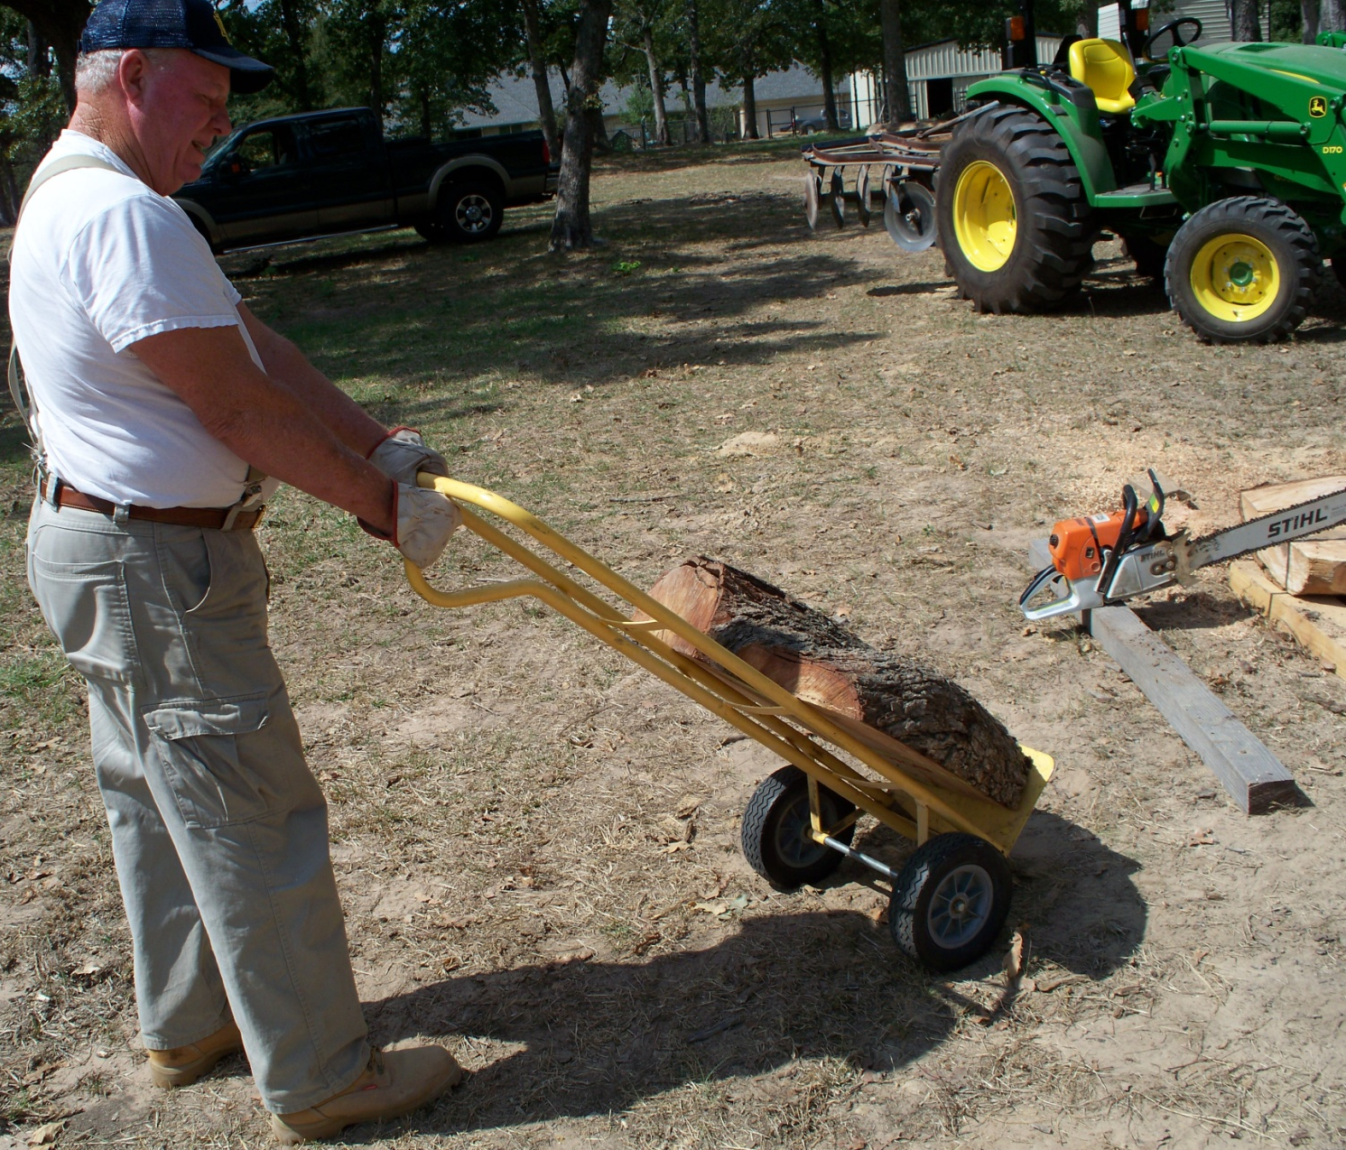
Transporting turning wood

Slide 12
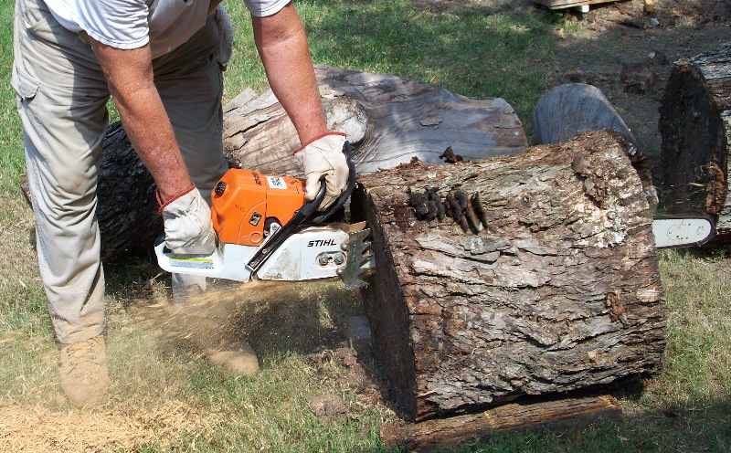
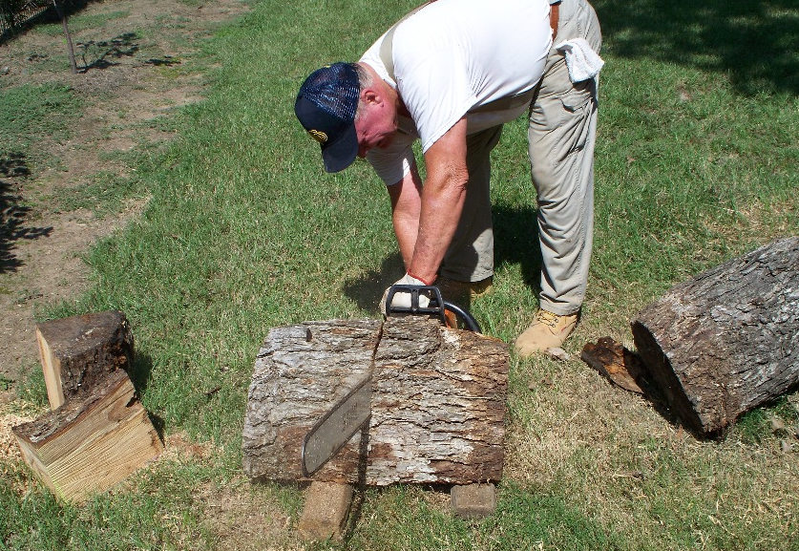
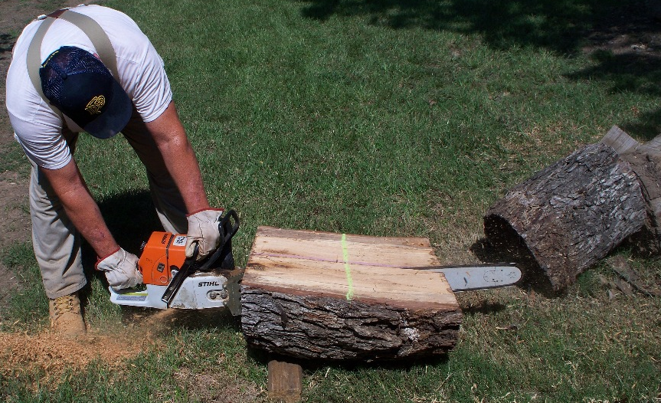
Transporting turning wood

Slide 13
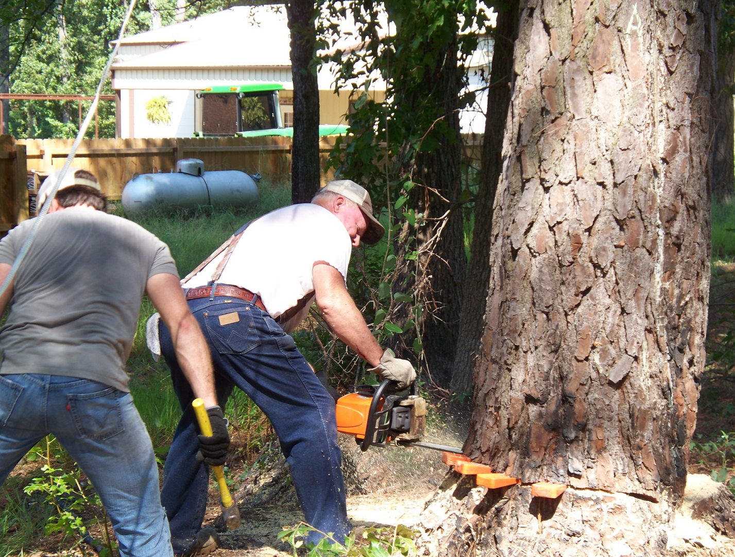
Felling a tree safely – the tools
Wedges
Plum bobs
Felling sticks
Chainsaws

Slide 14
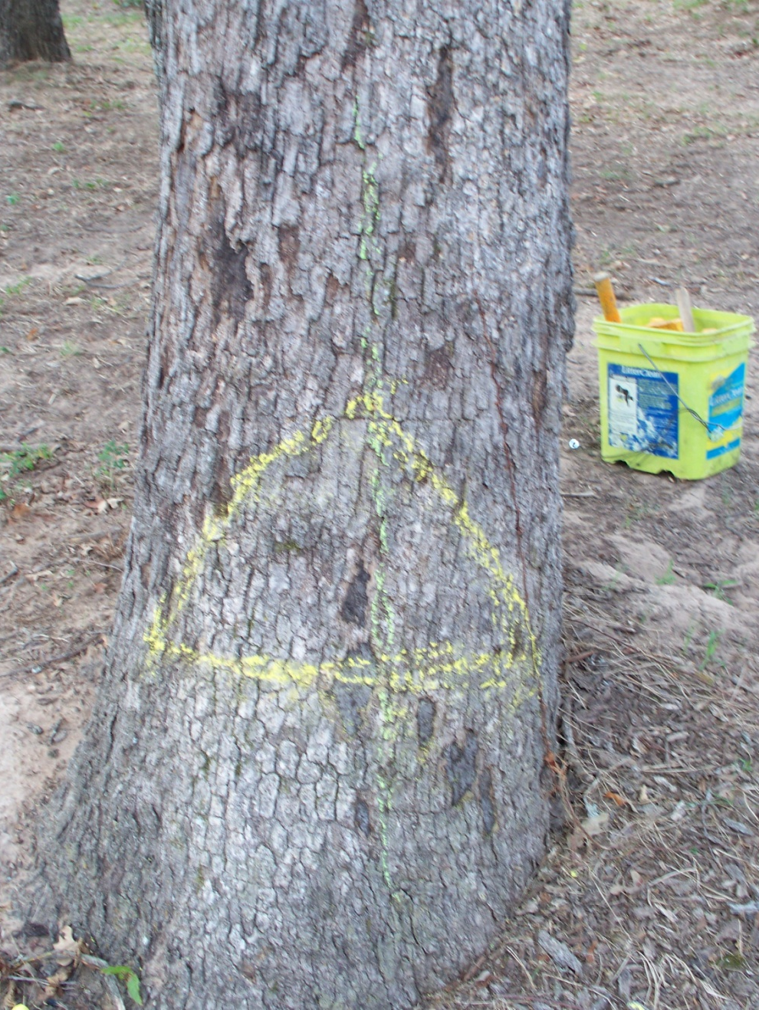
Felling a tree safely
Find the center line of the tree in the direction you want it to fall (green line)
Draw a triangle 80% of the width of the tree (yellow line)

Slide 15
Draw a line horizontal around the rest of the tree staying one to two inches above the bottom of the front triangle (purple line)

Slide 16
Cut out the front relief wedge

Slide 17
Start cutting from the back of the tree.
Plunge cut gets between second tree.

Slide 18
Apply wedges to back of the tree as soon as you have enough room. This keeps the tree from setting back on your saw. This also begins the tilting of the tree in the direction you want it to go.

Slide 19
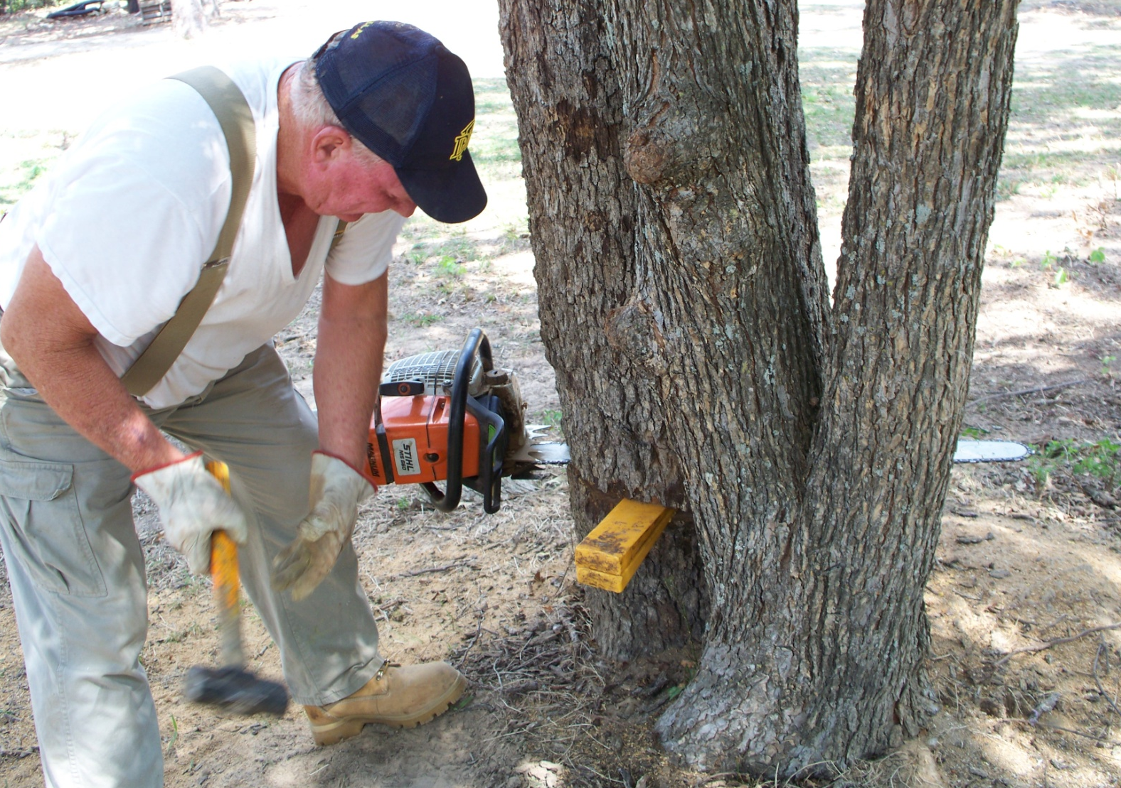
Stop the chain saw leaving two inches of wood at the front hinge. Double your wedges and beginning tilting the tree forward as you drive them in.

Slide 20
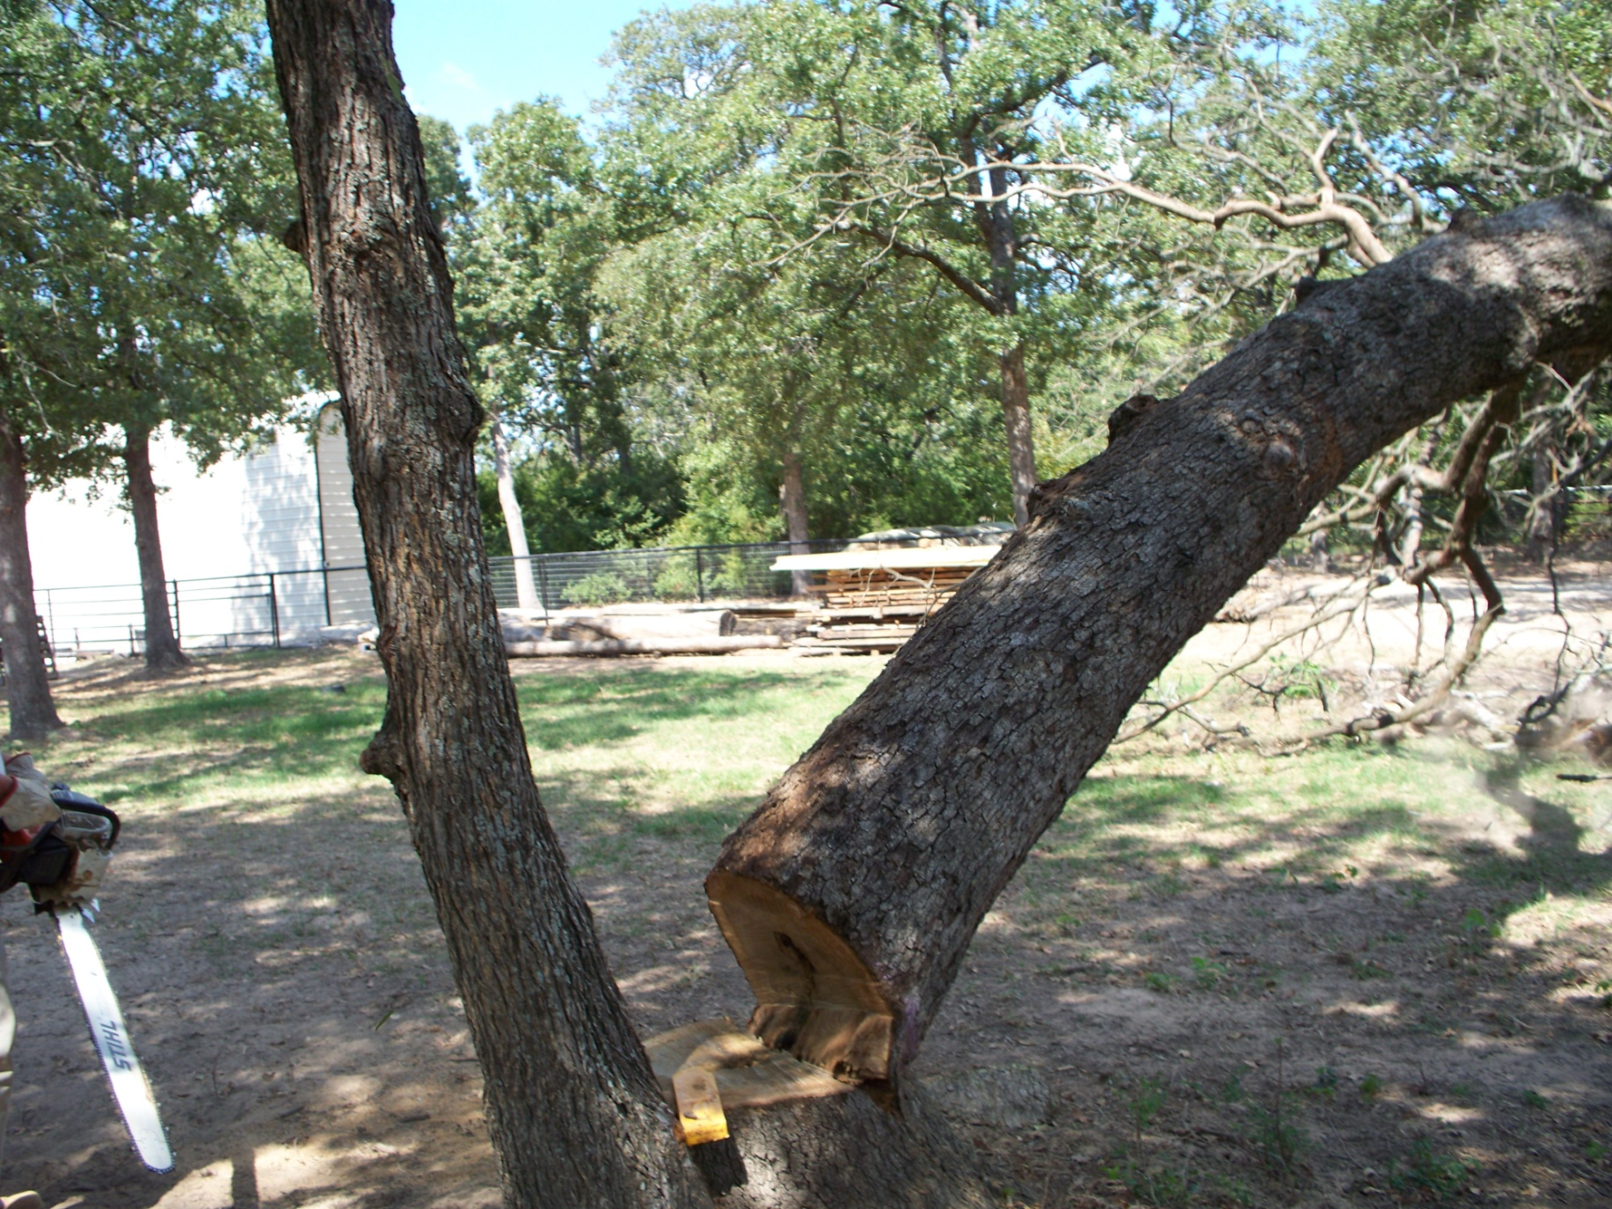
Timber! Done right

Slide 21
Dangers of a rotten core.
Mistakes people make cutting trees:
Cutting the relief cut to deep
Not leaving enough hinge thickness

Slide 22
Who’s cleaning up the mess of the unwanted wood?

Slide 23
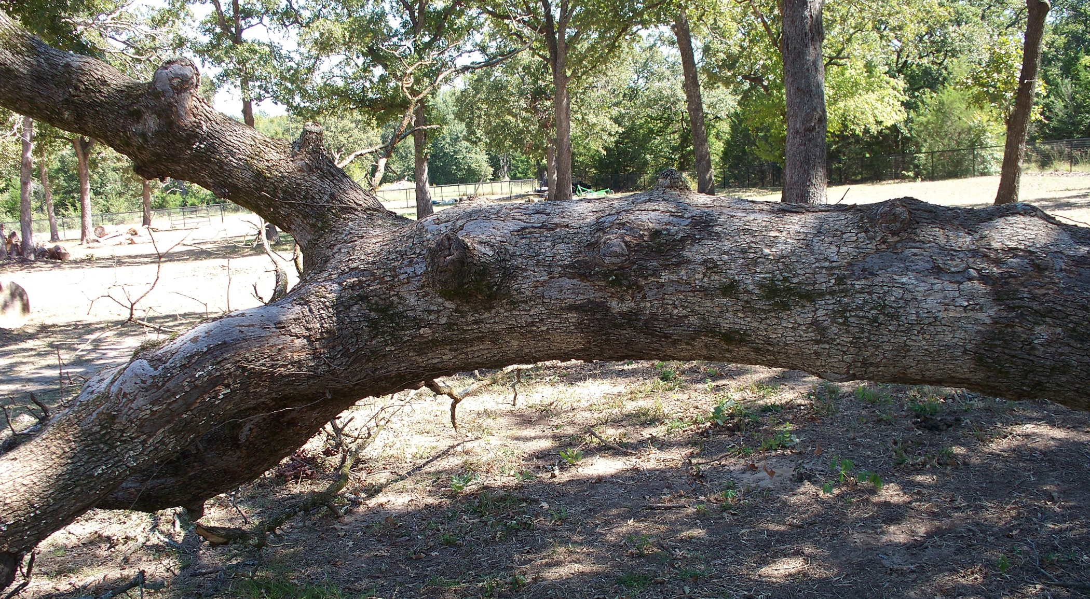
Where do you take your turning blanks from ???

Slide 24
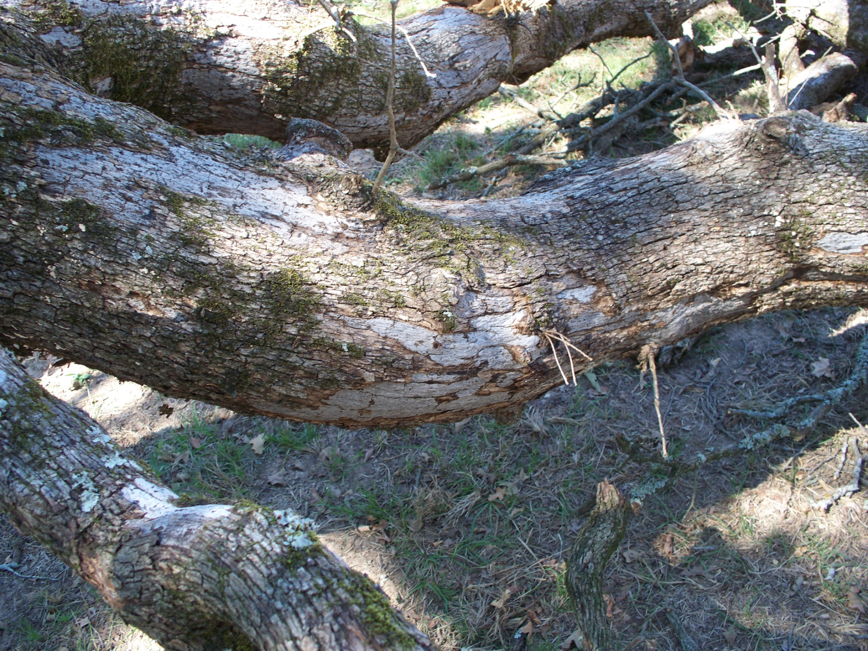

Slide 25
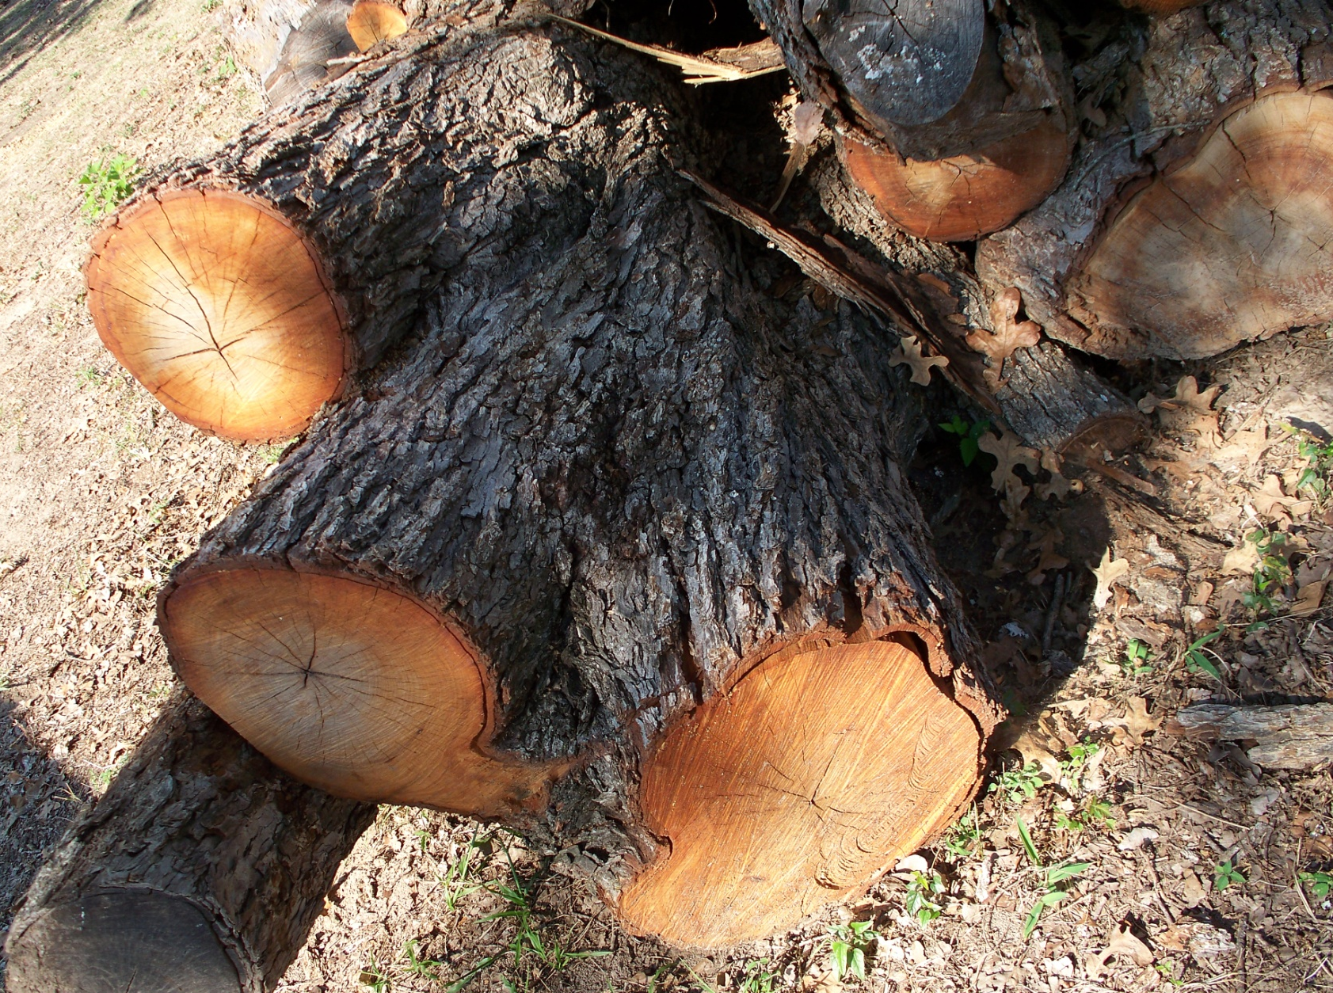
4 foot across

Slide 26
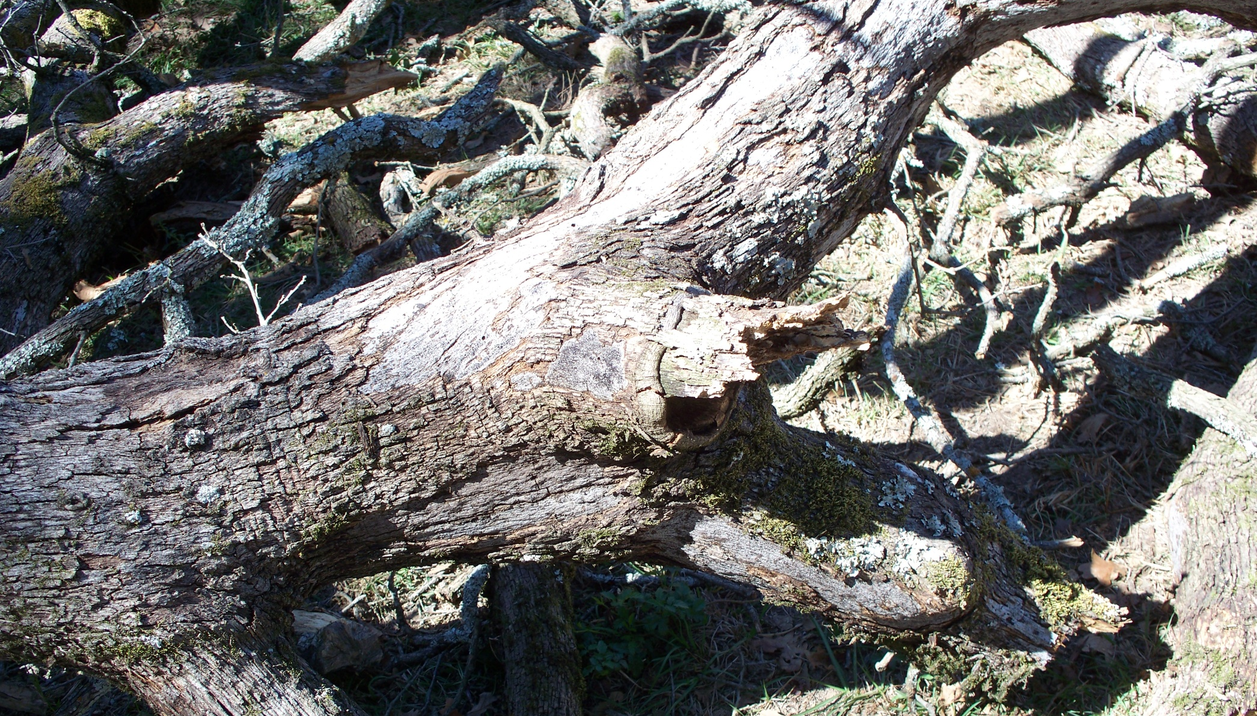
How BIG a piece of wood should you harvest for your turning blanks ???
Rotten limb extending into the core of the tree.

Slide 27
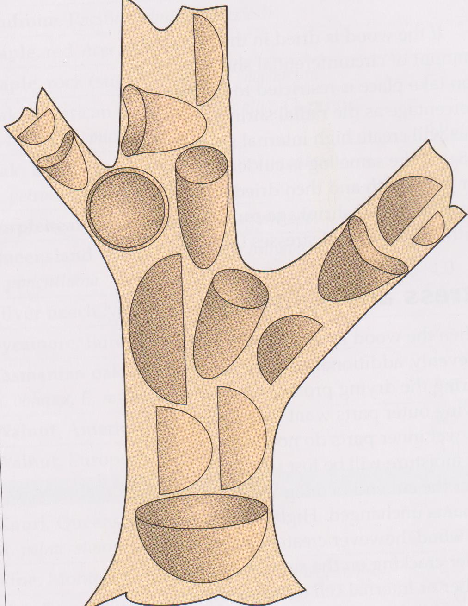
First Question: What type of turning blank do you want from this tree ???
Second Question: What portion of the tree should you harvest your turning blank from ???

Slide 28
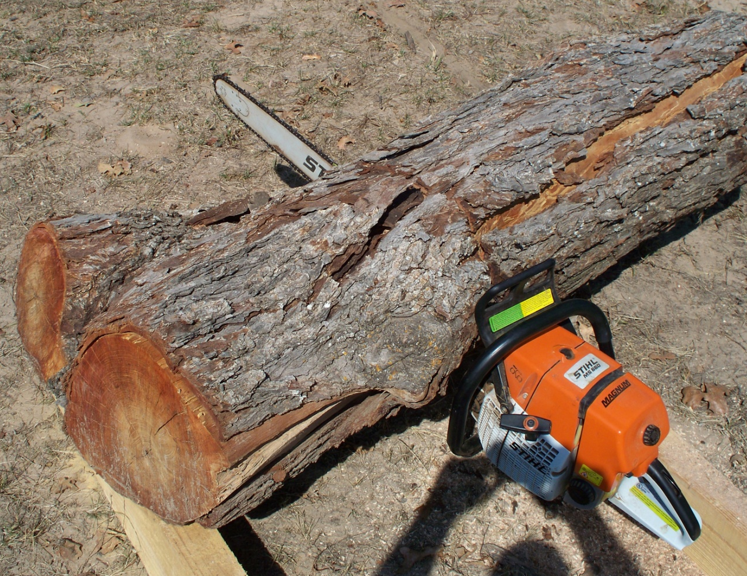
Processing the wood for storage and turning
200 lbs. of Pecan wood

Slide 29
Crotch Figure

Slide 30
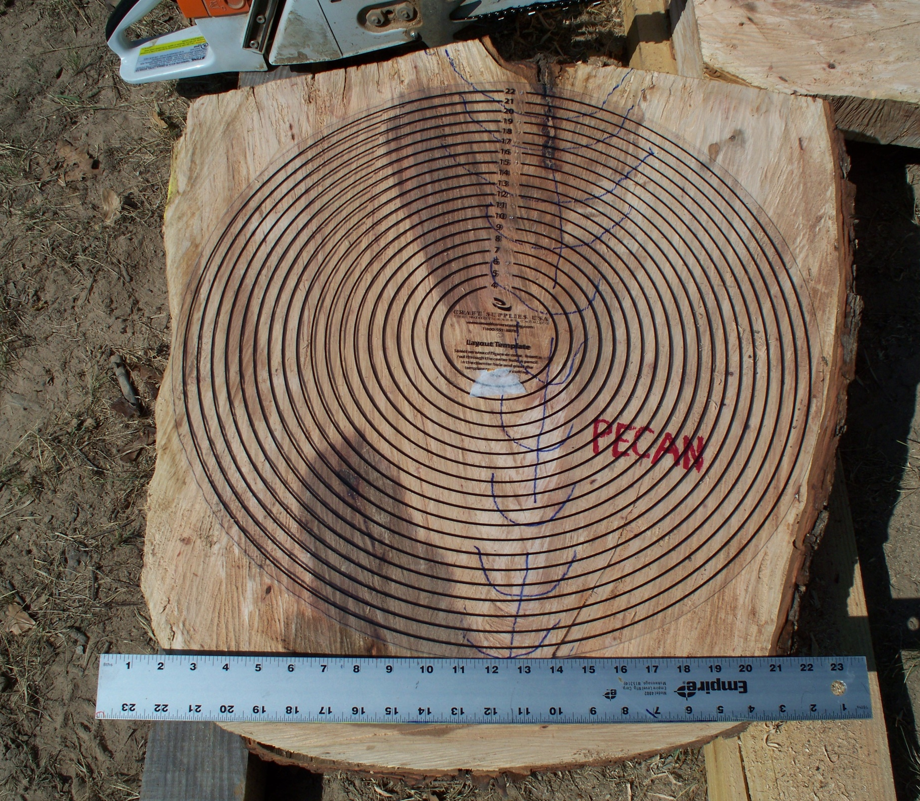

Slide 31
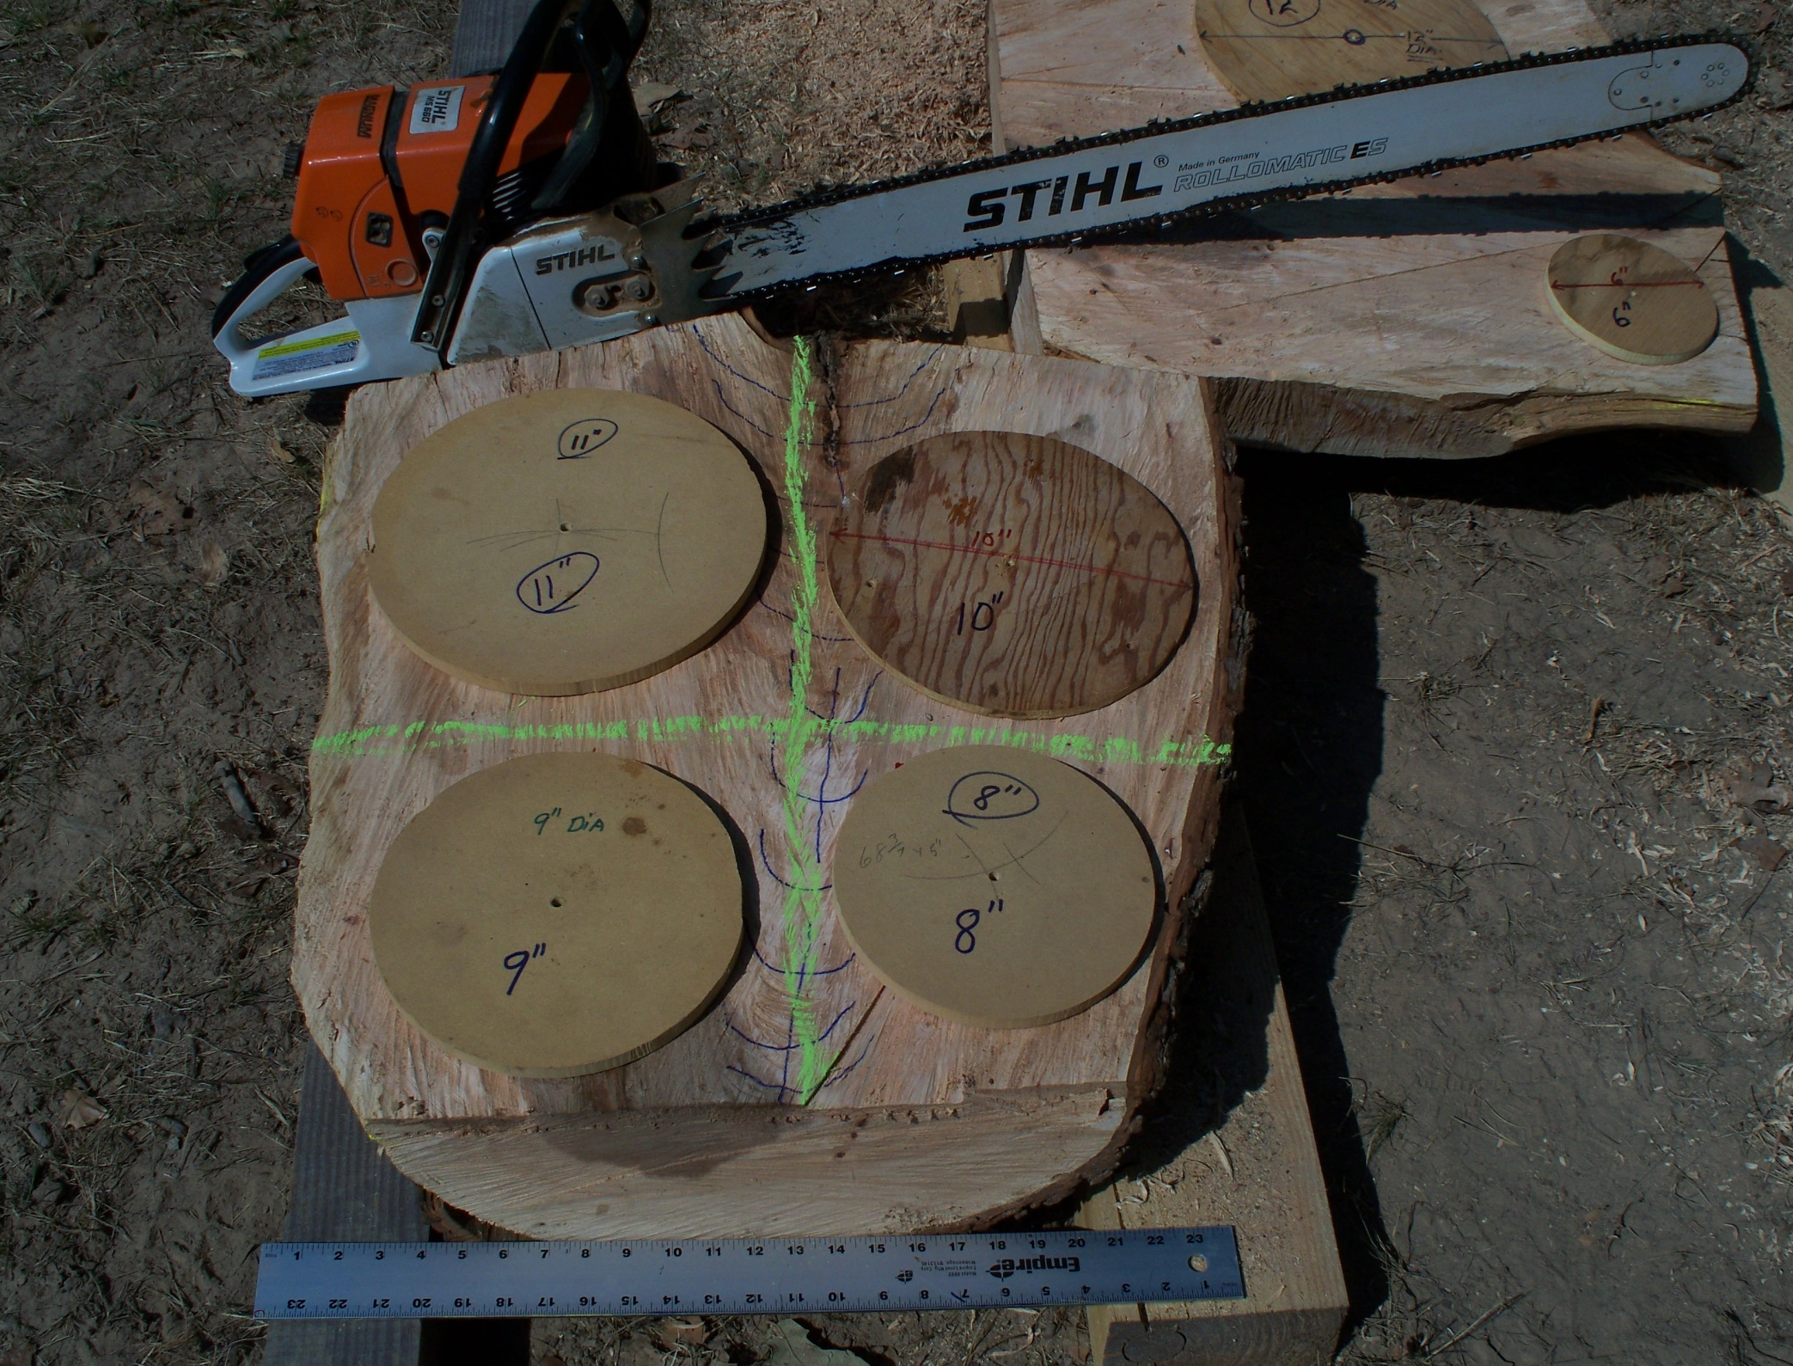

Slide 32
Processing the wood for storage and turning

Slide 33
Processing wood for turning and storage

Slide 34
The proceding slides dealt with processing green wood for bowl blanks.
How would you process turning blanks for making a round vase ???

Slide 35
Preparing wood blanks for turning

Slide 36
Preparing wood blanks for turning
Saving the best Spalted wood
Spalted Pecan

Slide 37
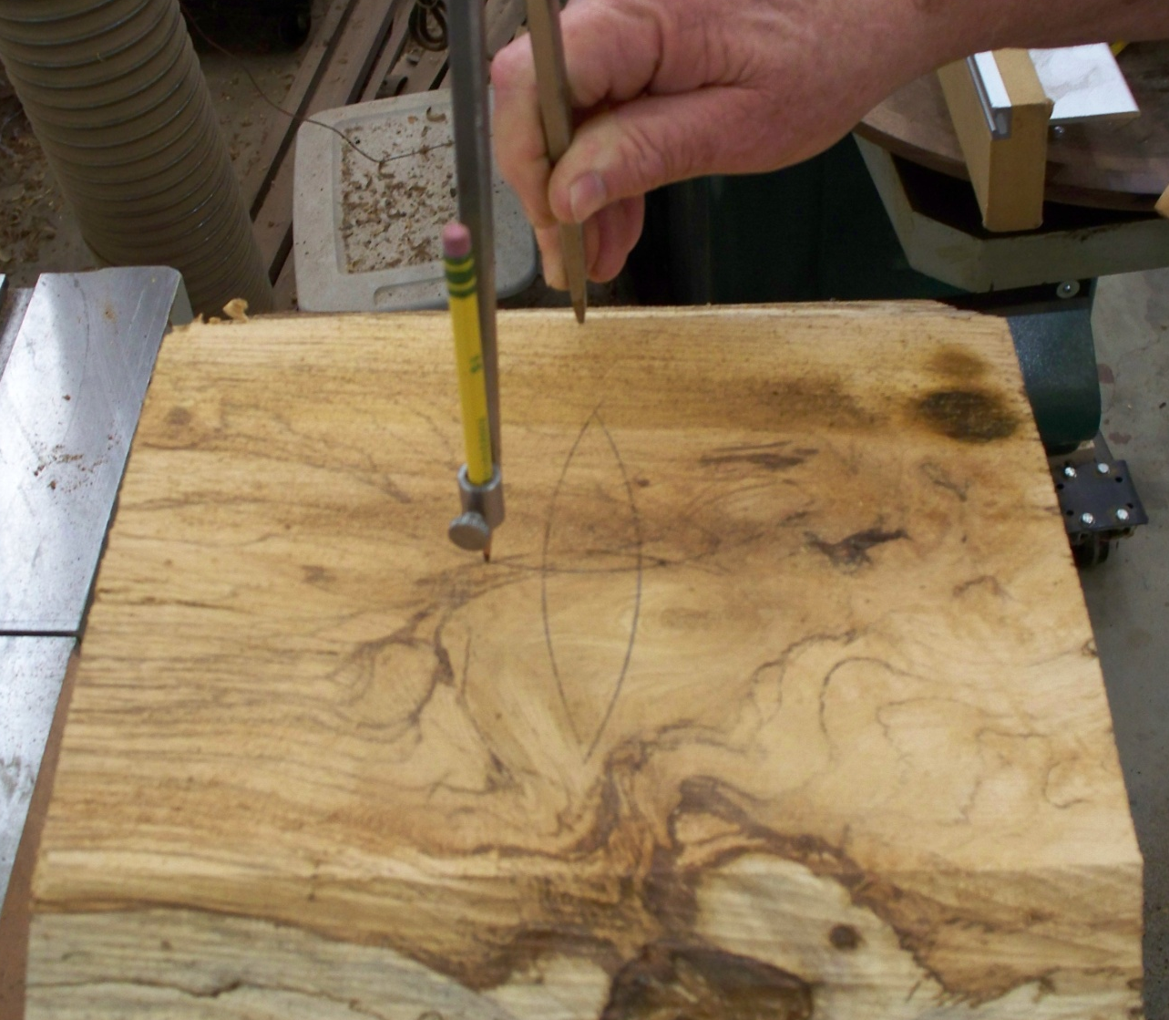
Preparing wood blanks for a circle turning jig
Drill a 3/8” hole
1” deep
Find the center

Slide 38
Preparing wood blanks for a circle turning jig
¼” Cap screw with a 3/8” head
3/8” Screw chuck

Slide 39
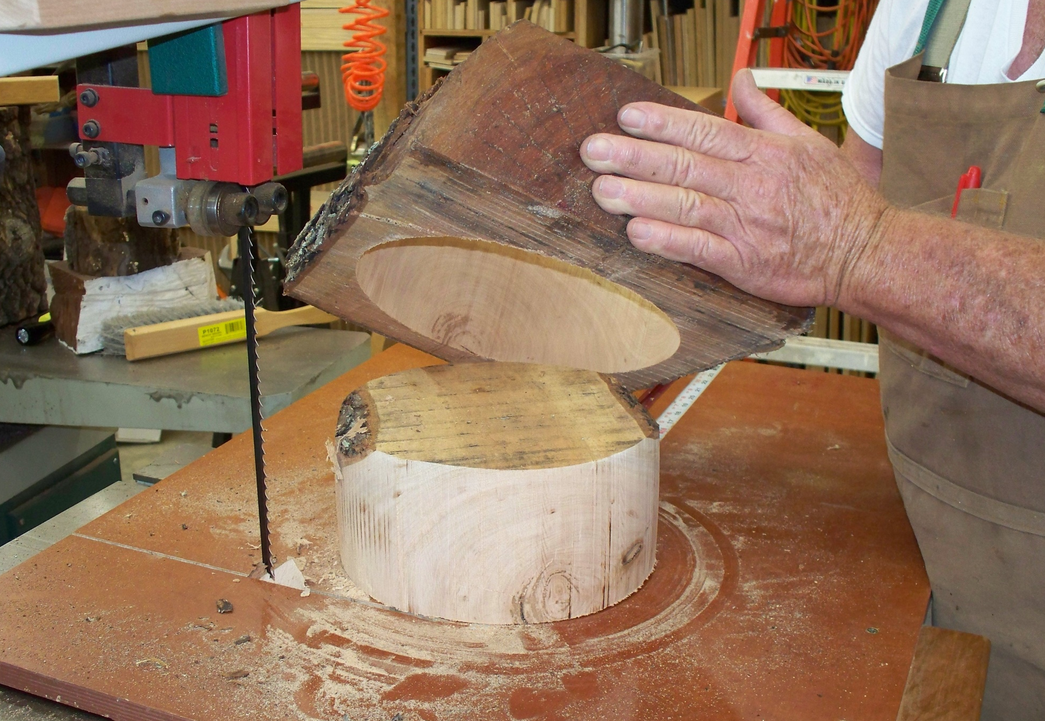
Preparing wood blanks for turning

Slide 40
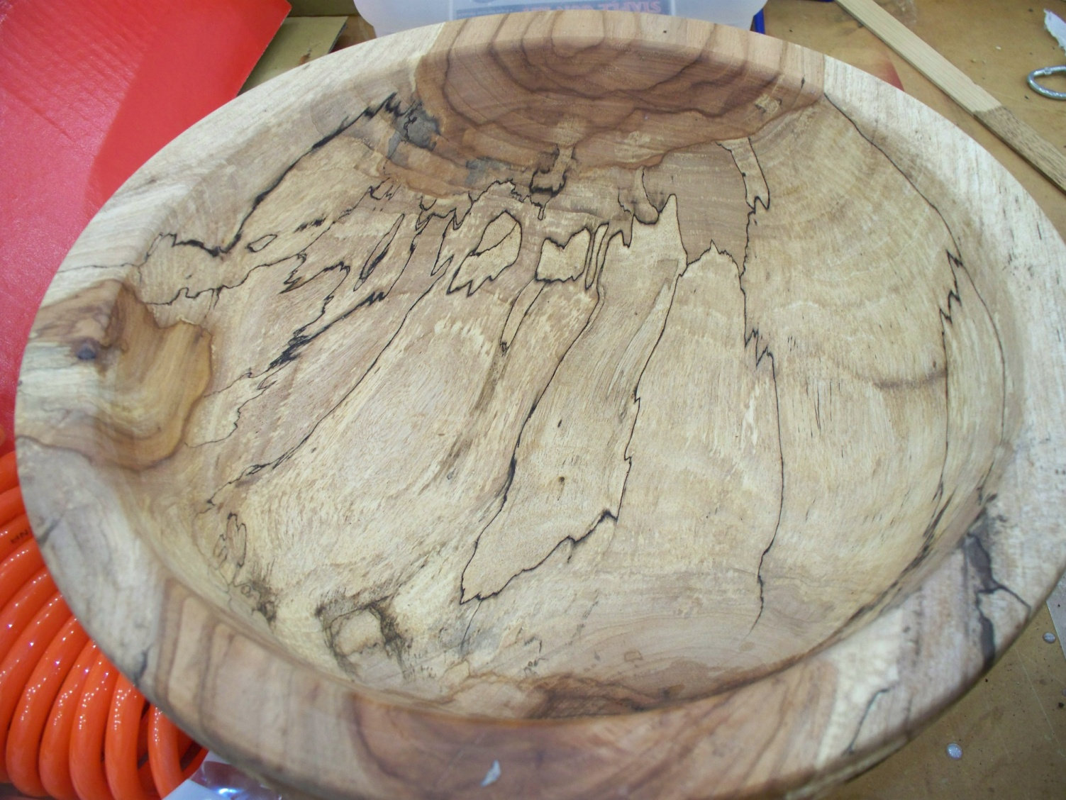
Spalting green wood in a Fungi Farm to enhance its beauty

Slide 41
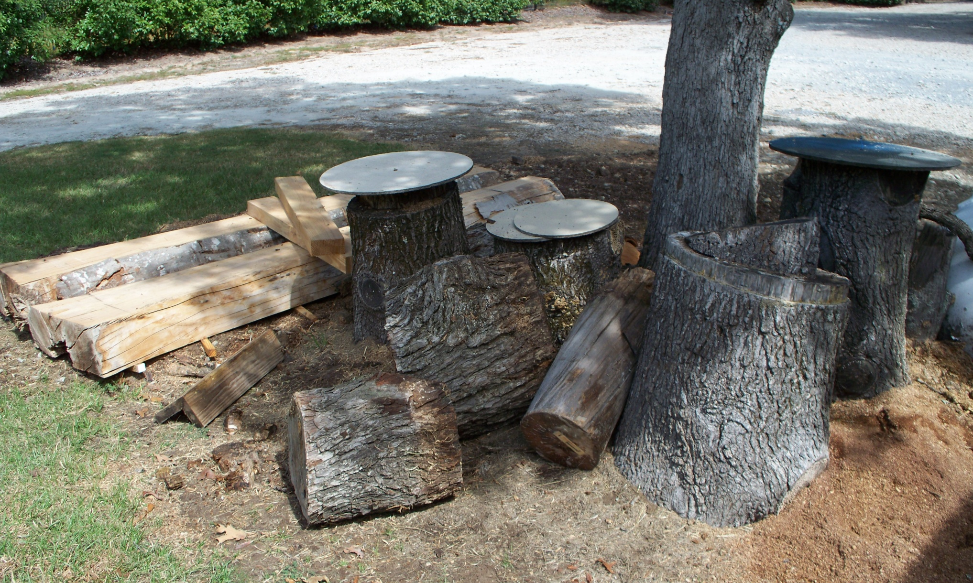
Spalting green wood in a Fungi Farm to enhance its beauty

Slide 42
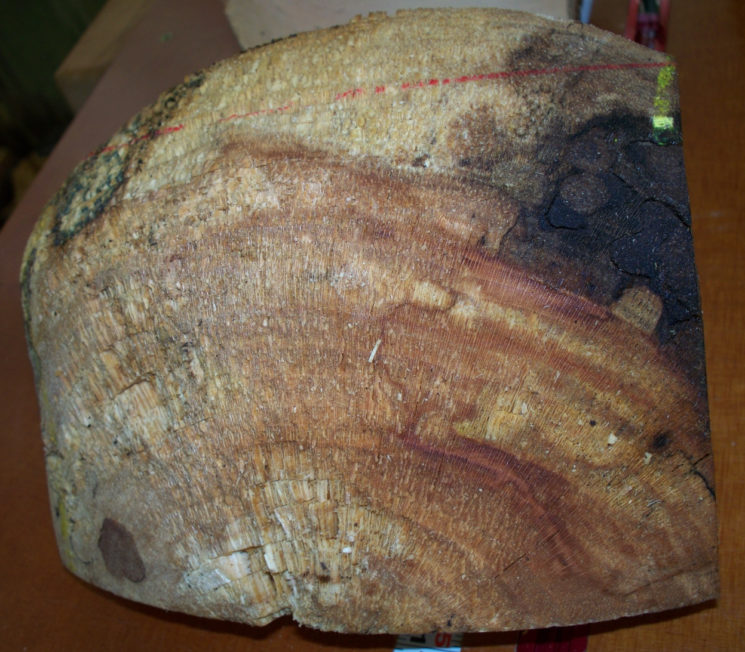
Spalting is the beginning stages of fungi attack that will result in rotting of the wood given enough time.
Pecan
Sycamore

Slide 43
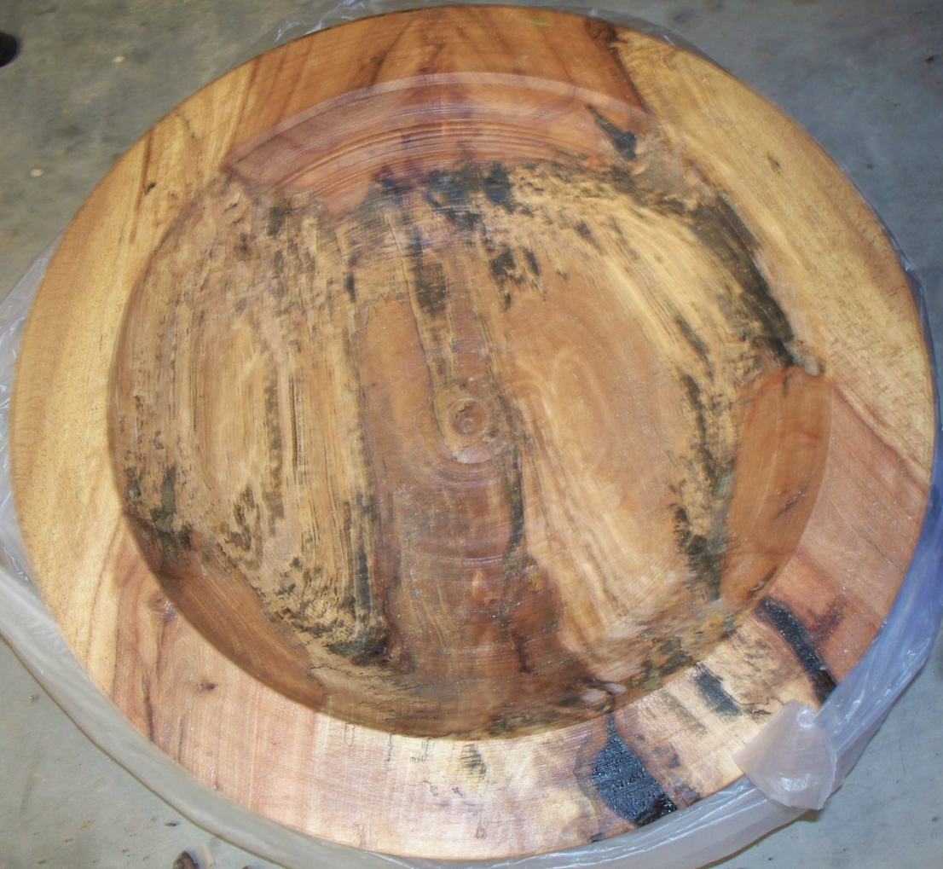
The spalting process needs three things, the decay spores, moisture, and heat. In fresh cut wood, the spores and water are already there. In Texas you have high heat.
Rough turned, green, wet Beech platter coated with Anchor Seal wax will enhance Spalting.

Slide 44
Spalting green wood in a Fungi Farm to enhance its beauty
Woods that Spalt easily and beautifully
Pecan
Hickory
Sweetgum
Maple
Cherry
Bradford Pear
Beech
Pine
Other light colored woods
Woods that are hard to Spalt or it doesn’t show up in the wood.
Sycamore
Black Walnut
Mesquite
Bois d” Arc
Red Cedar

Slide 45
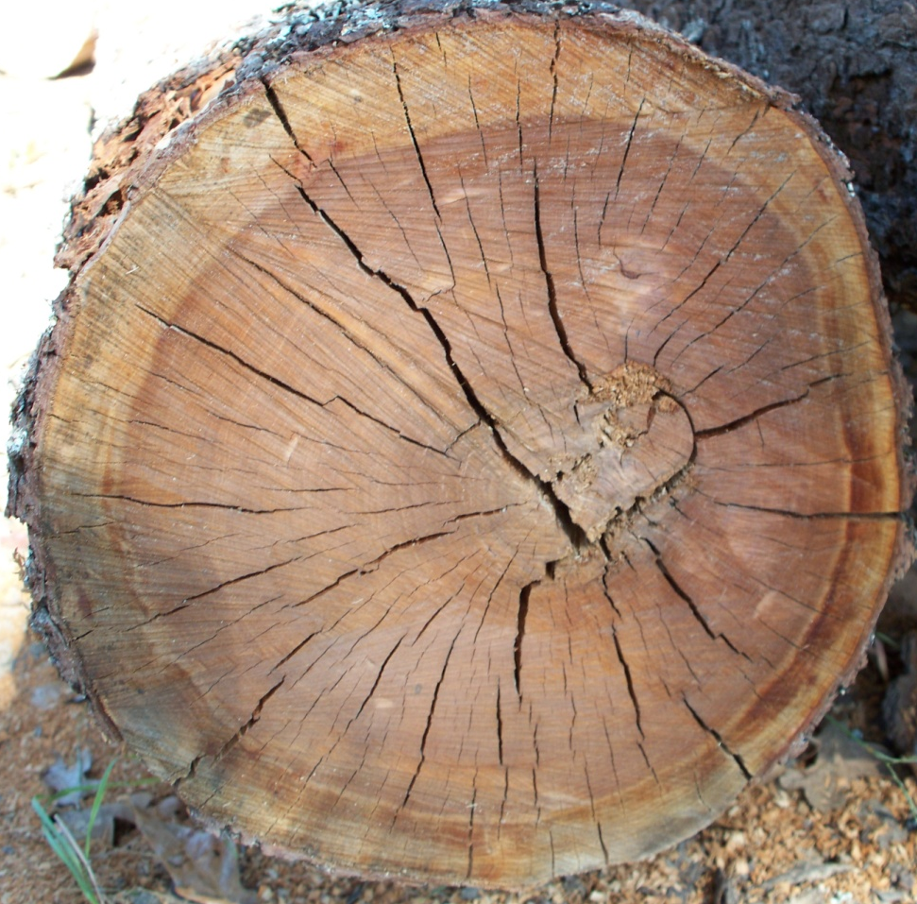
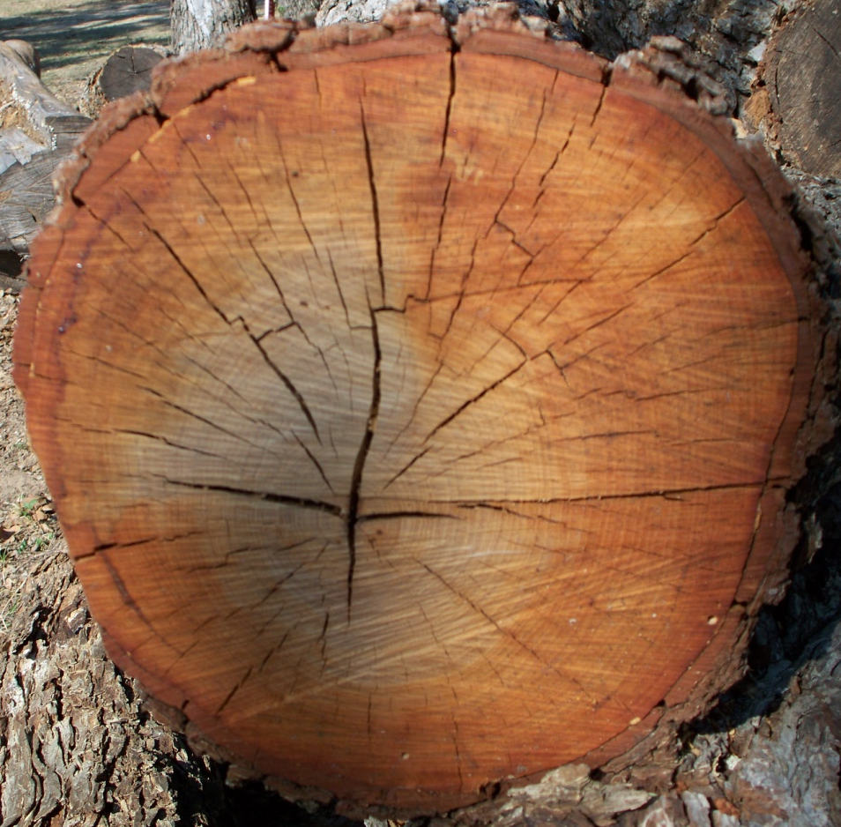
Shrinkage and Distortion of green wood
Removal of moisture from the felled tree to levels below the fiber saturation point (about 32% water) causes the wood to shrink.
Cherry
Pecan

Slide 46
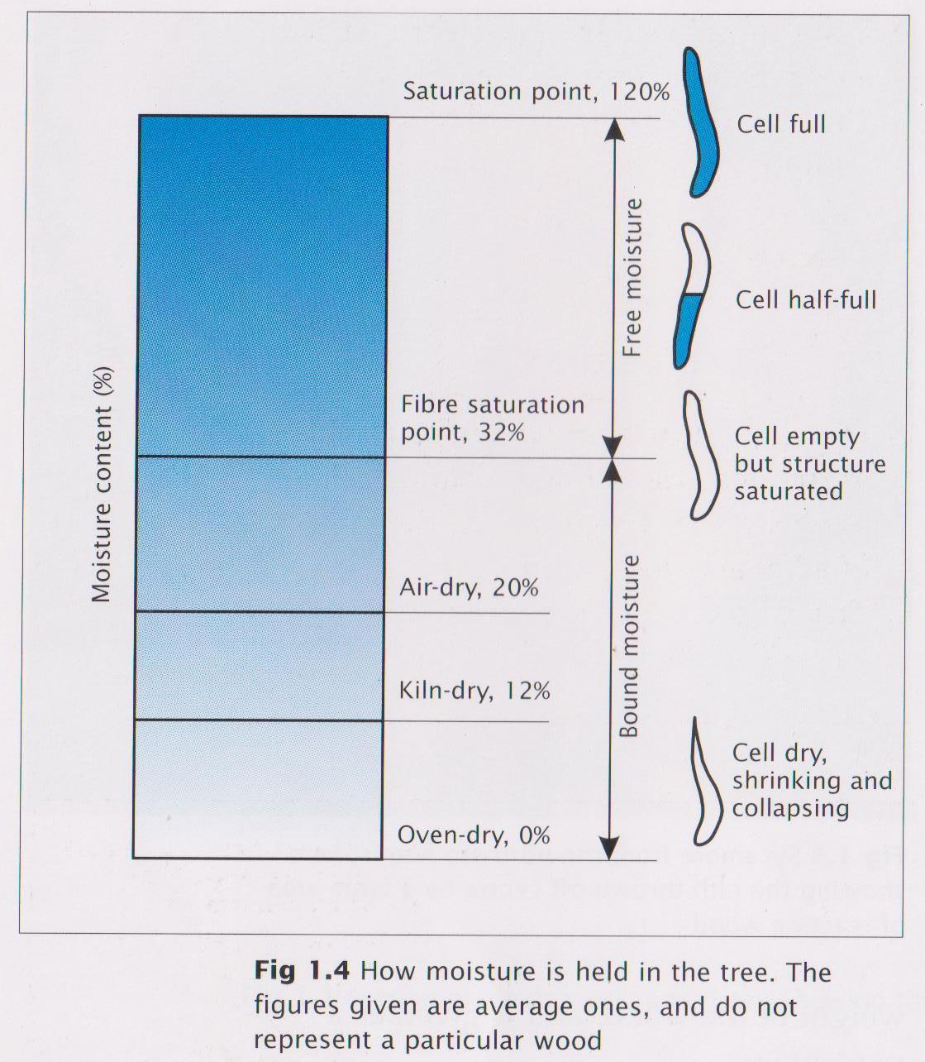
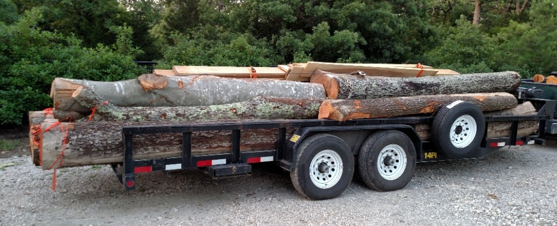
Shrinkage and Distortion of green wood
The water/paper towel example.
The beech wood example.

Slide 47
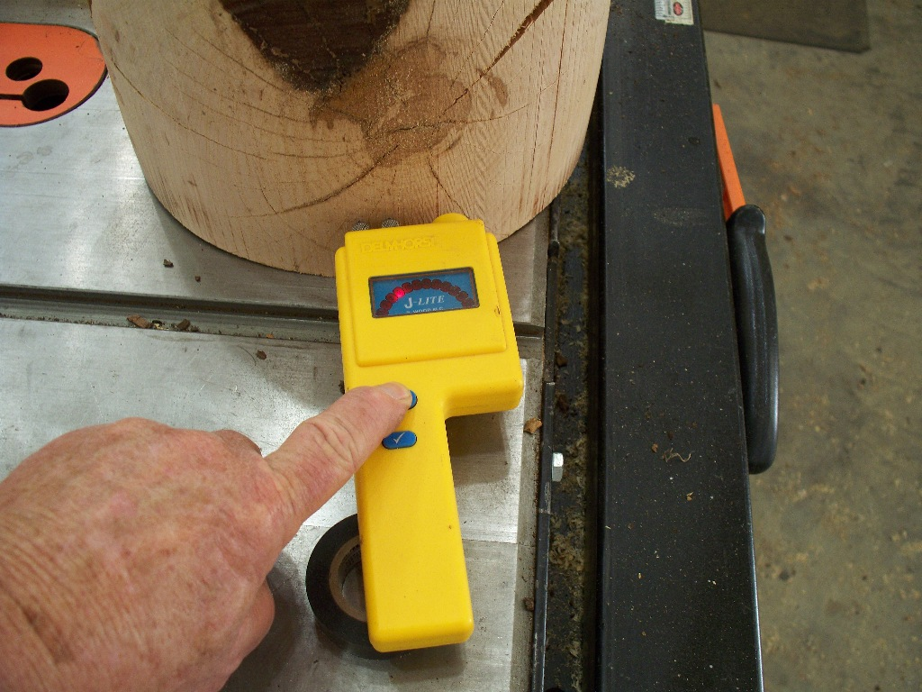
Shrinkage and Distortion of green wood
Use a moisture meter to determine the percent of moisture left in green wood.

Slide 48
Shrinkage and Distortion of green wood
Green Ash
Mesquite

Slide 49
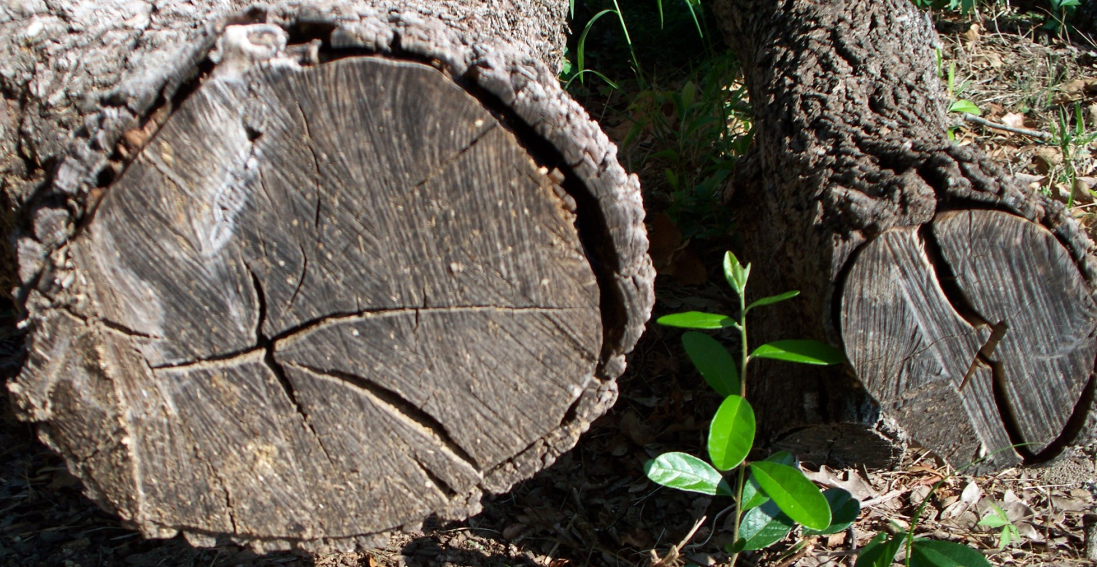
Shrinkage and Distortion of green wood
Eastern Red Cedar
“Juniperus Virginiana”
Different woods shrink at different rates
Hickory

Slide 50
Shrinkage and Distortion of green wood
Bois d” Arc
Osage Orange
Horse Apple Tree
Sweet Gum

Slide 51
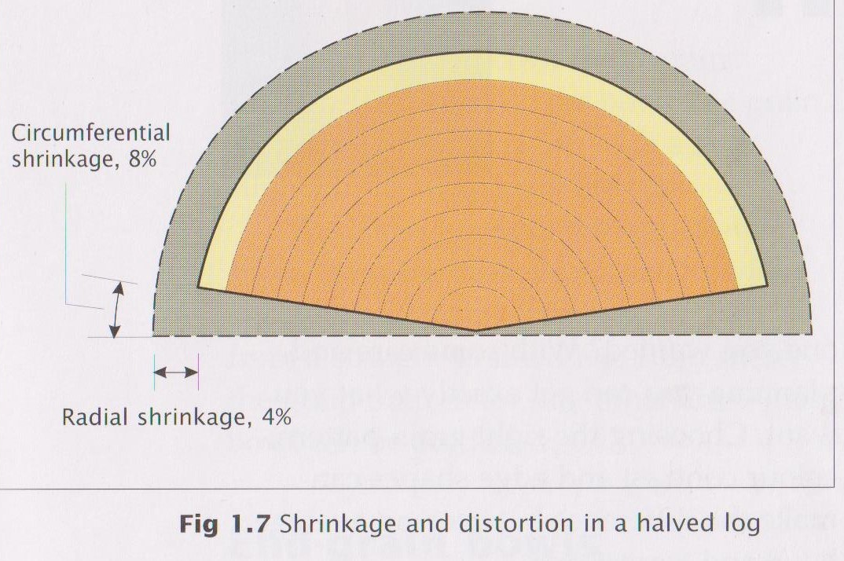
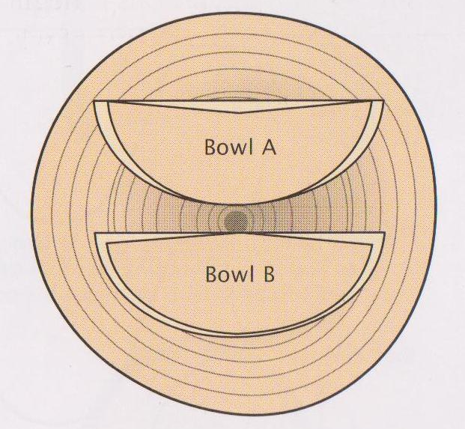
Shrinkage and Distortion of green wood
Average shrinkages,
fibre saturation point (FSP)(32%)
to 12% moisture content.
 | Radial | Circumferential | Ratio
Hardwoods | % | %
Ash | 4.5 | 7.0 | 1.6
Cherry | 3.5 | 6.5 | 1.9
Elm | 4.5 | 6.5 | 1.4
Holly | 5.0 | 12.0 | 2.4
Sugar Maple | 2.5 | 5.0 | 2.0
White Oak | 3.0 | 5.5 | 1.9
Purple Heart | 2.0 | 4.5 | 2.3
Beech | 3.0 | 6.0 | 2.0
Sycamore | 2.5 | 5.5 | 2.2
Walnut | 2.5 | 3.5 | 1.4
Softwoods
Pine | 2.5 | 4.0 | 1.6

Slide 52
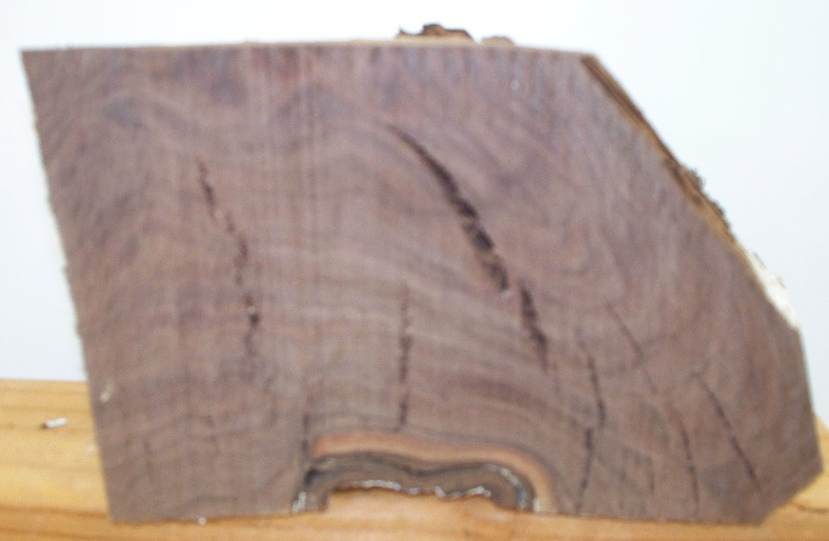
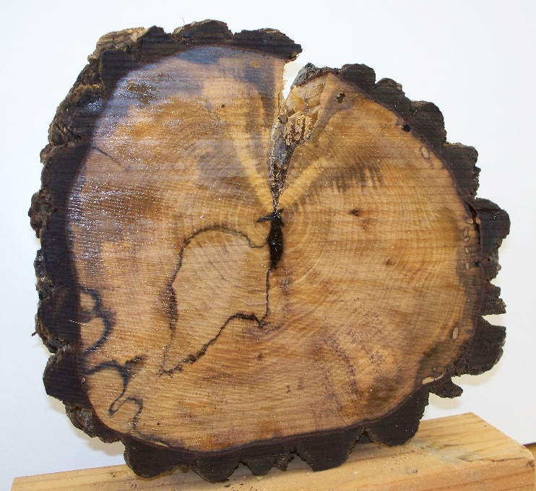
Shrinkage and Distortion of green wood
Circumferential shrinkage on persimmon wood
Shrinkage of crooked grain Walnut root

Slide 53
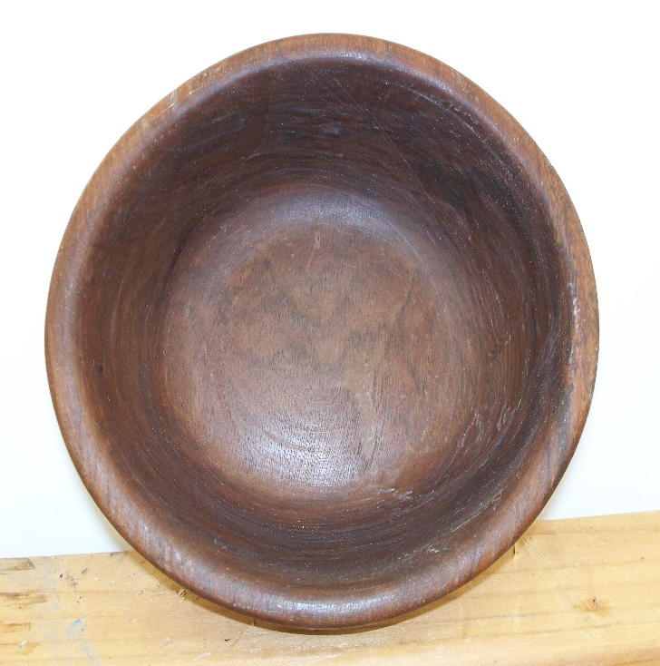
Shrinkage and Distortion of green wood
2. Black Cherry off-cut
1. Walnut Root
3. Beech slab 2” thick
4. Walnut turning blank 2” x 20”

Slide 54
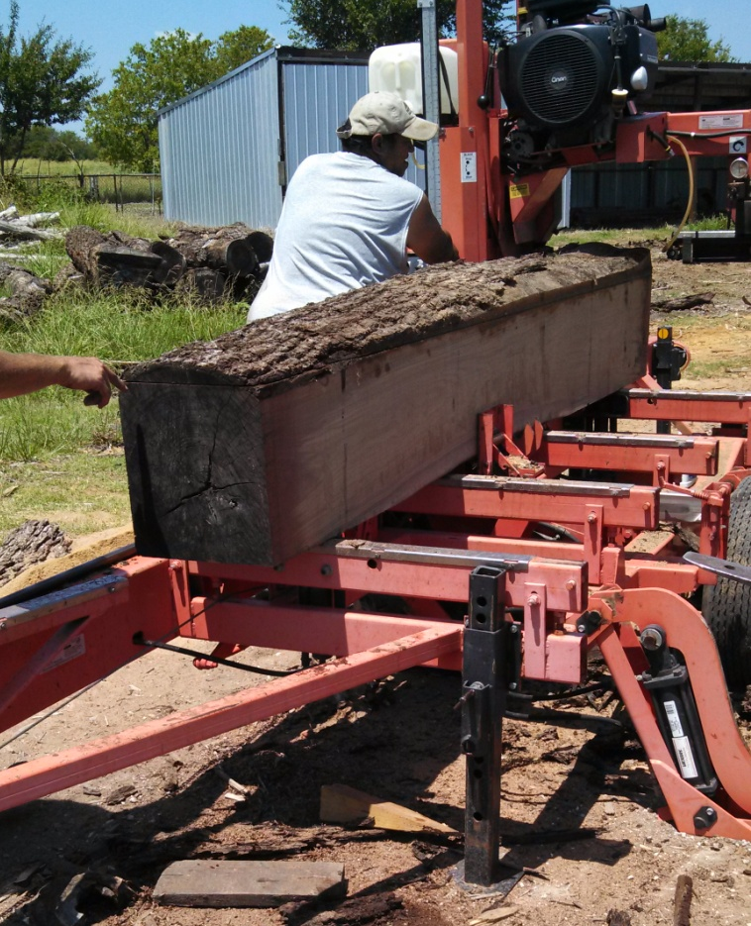
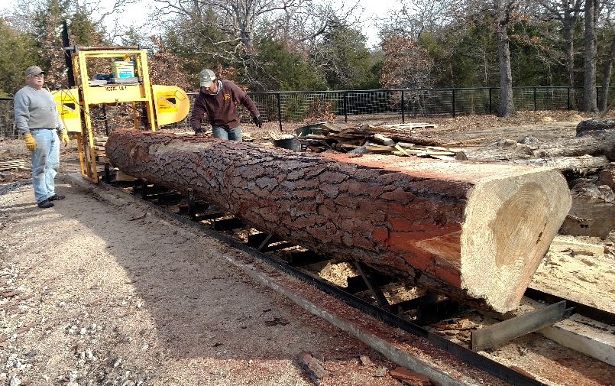
Shrinkage and Distortion of green wood
Have a saw mill cut your wood into two, three or four inch slabs so it will dry faster. Slabs make great shallow bowls and platters.

Slide 55
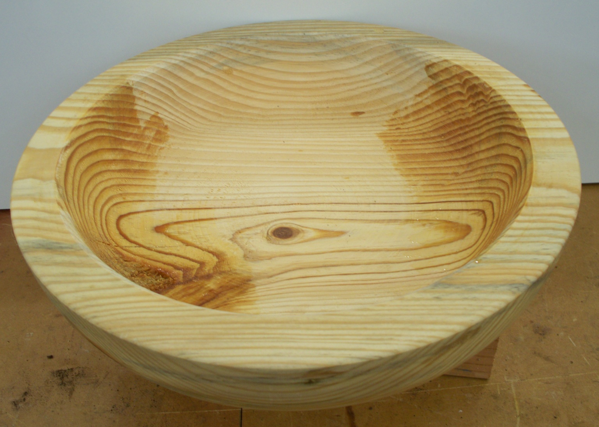
Shrinkage and Distortion of green wood
One of the ways to deal with shrinkage and distortion of your bowl is to rough turn it and leave the walls thick until its dry. Wall thickness should be left 1 to 1 ½” inches

Slide 56
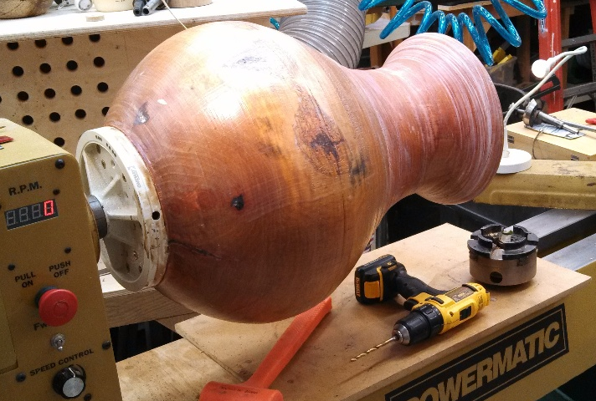
Shrinkage and Distortion of green wood
Bradford Pear – Which way will it warp and distort during drying?

Slide 57
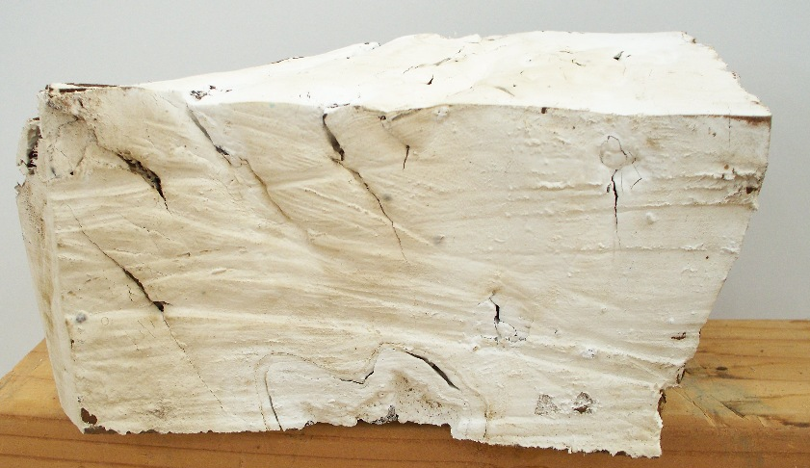
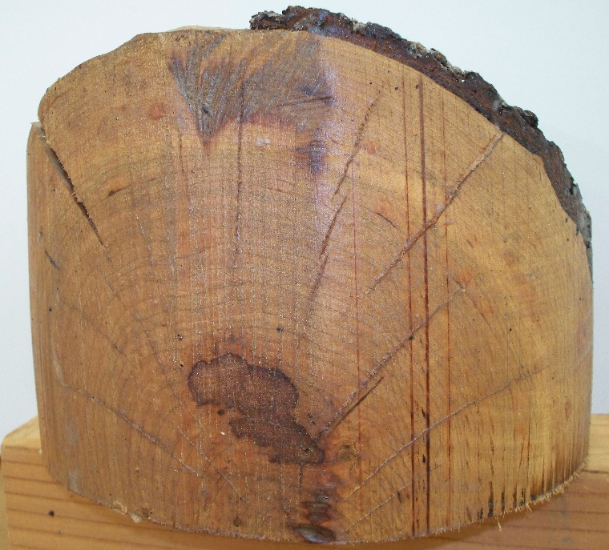
Controlling Shrinkage and Distortion
You can control the rate of moisture release by applying coatings to slow down drying of the wood.
Walnut Root with Latex Paint
Cherry with Anchor Seal
Black Walnut with Paraffin Wax

Slide 58
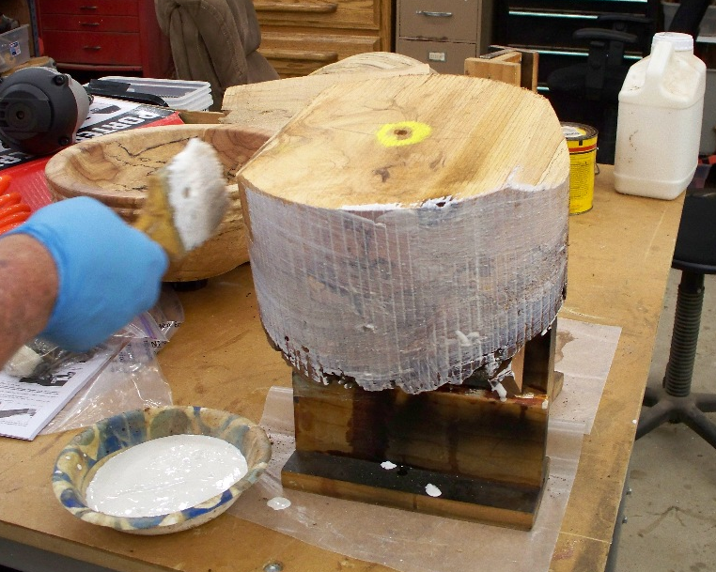
Controlling Shrinkage and Distortion
Applying anchor seal to slow drying and distortion of wood.

Slide 59
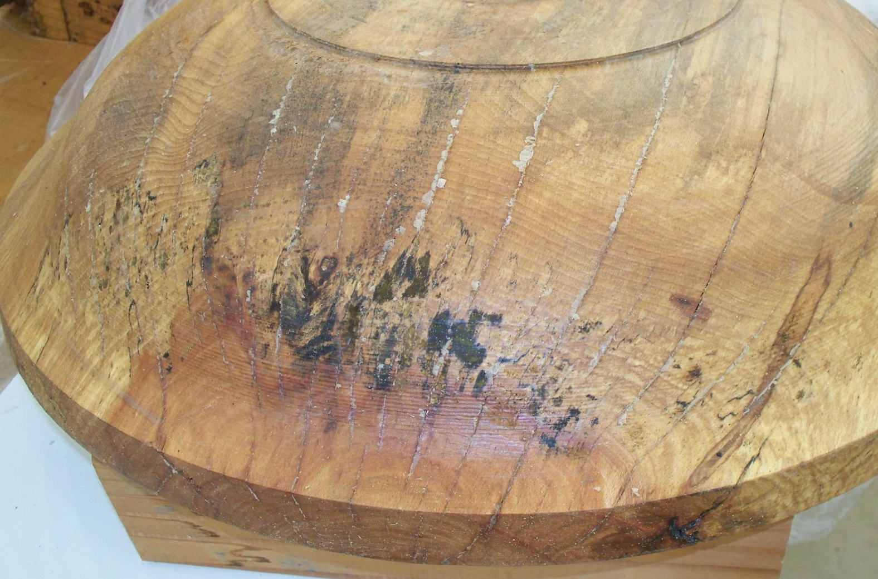
Controlling Shrinkage and Distortion
A bowl that was allowed to dry to much on the outside, causing stress cracks to open up. Anchor Seal was applied.
As the moisture equalizes through out the bowl the cracks are closing up and the anchor seal is being squeezed out of the cracks.

Slide 60
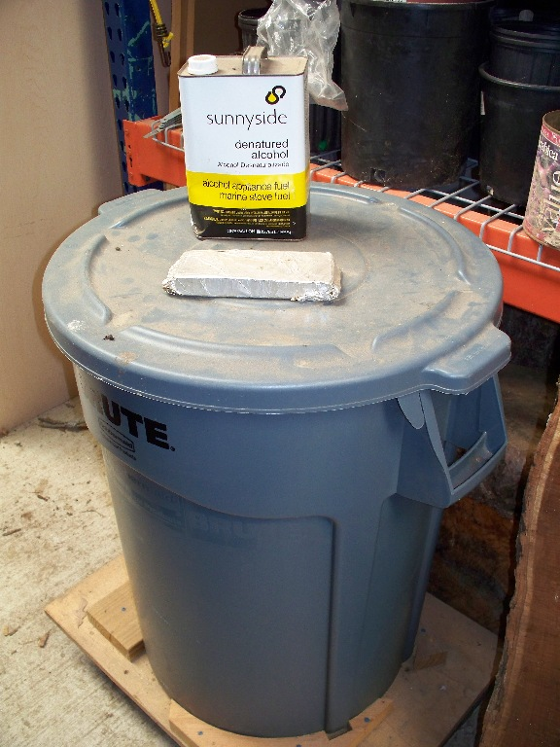
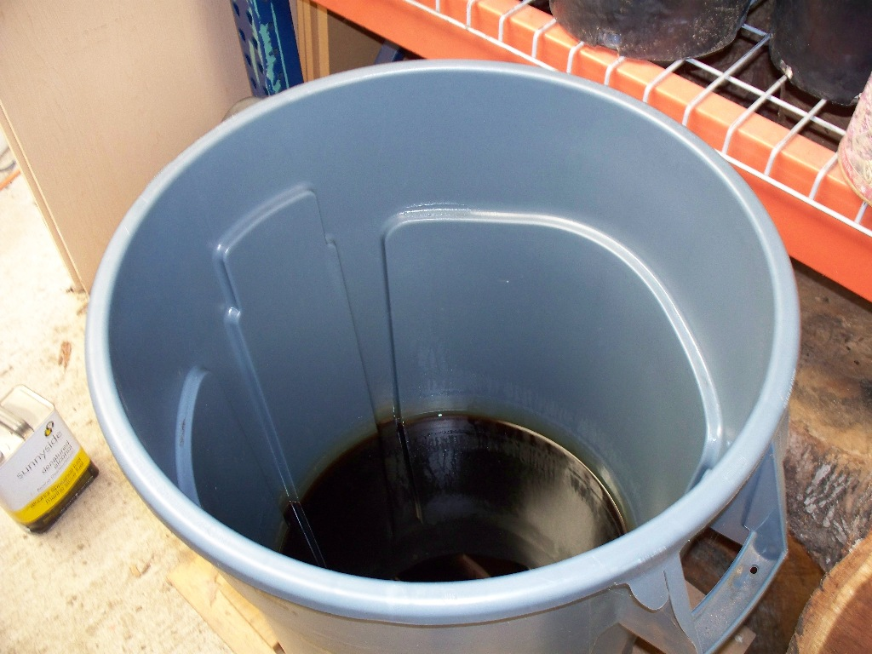
Controlling Shrinkage and Distortion
You can remove the water from the wood fibers by immersing in a alcohol bath for 48 hrs. This will help control shrinkage.
Mixed results from this.

Slide 61
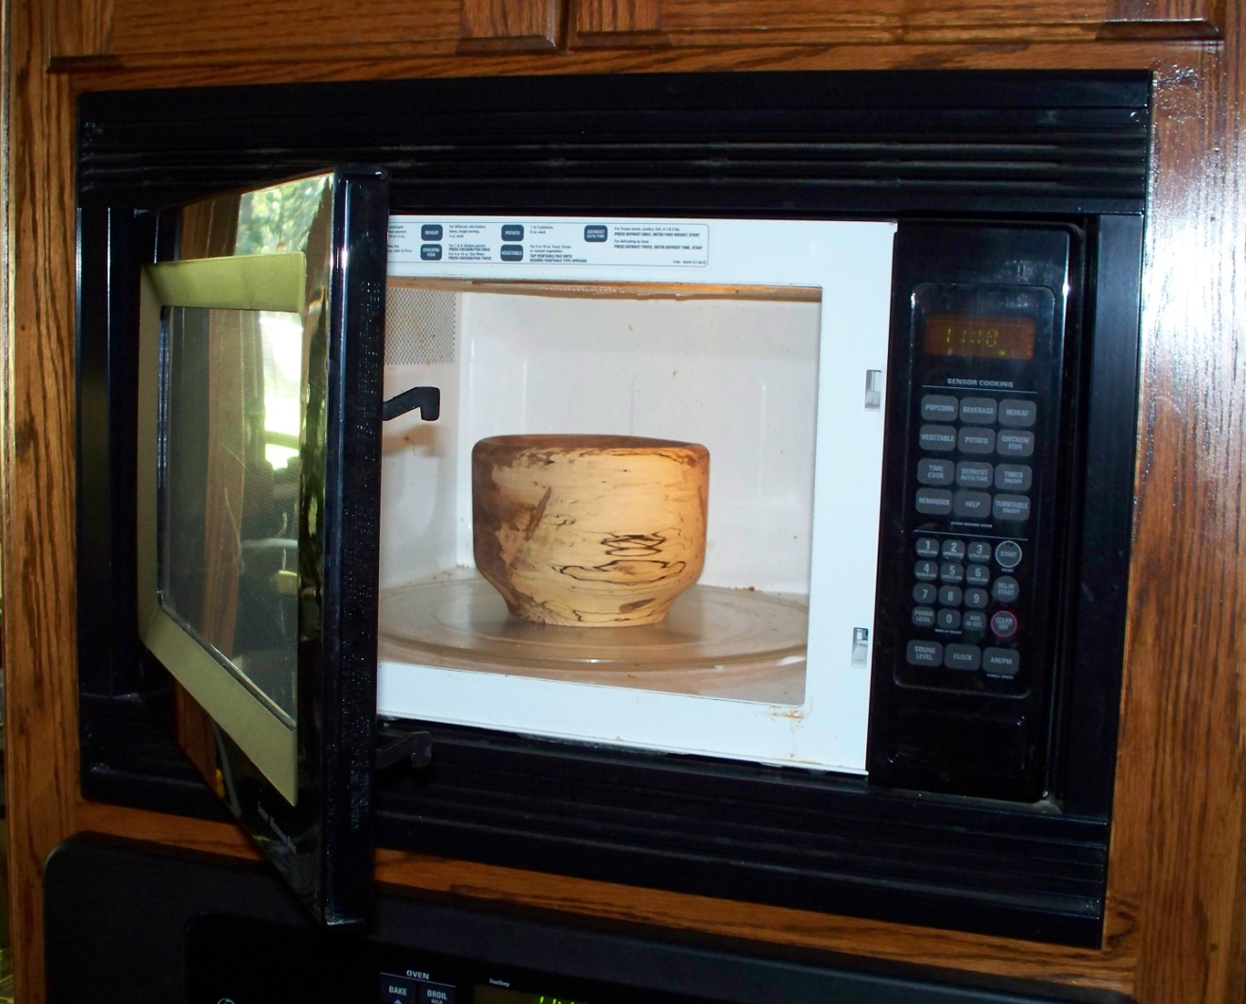
Controlling Shrinkage and Distortion
Microwave drying can speed up drying of a bowl. Must be done slowly and at low heat with repeated cycles.

Slide 62
Controlling Shrinkage and Distortion
How uncontrolled drying leads to differential drying in different parts of the bowl

Slide 63
Controlling Shrinkage and Distortion
Black Walnut Vase
Air Hole
Wrapping the outside of a bowl or vase slows down the outside drying while allowing the inside to dry faster. This reduces cracking.

Slide 64
Controlling Shrinkage and Distortion
Plastic bag used to slow down drying on the bottom of the bowl while allowing the top side to dry quicker.

Slide 65
Controlling Shrinkage and Distortion
Other methods of relieving stress in wood as
it is drying.
Steaming wood in a steam chamber will help relieve stress and speed drying.
Boiling in water relieves stress and speeds drying.

Slide 66
Dealing with holes, knots, cracks & crooked grain woods
Our repair arsenal

Slide 67
Dealing with holes, knots, cracks & crooked grain woods
Making wood crack filler using natural wood. Mix with clear epoxy and fill your holes and cracks so they match.

Slide 68
Dealing with holes, knots, cracks & crooked grain woods
Holes
Filler

Slide 69
Dealing with holes, knots, cracks & crooked grain woods
Epoxying structural weakness cracks for safety before and during turning.
Mesquite
Walnut

Slide 70
Dealing with holes, knots, cracks & crooked grain woods
The Red Cedar Vase
1.
2.
3.
4.
5.
6.

Slide 71
Dealing with holes, knots, cracks & crooked grain woods
Filling the cracks with epoxy
Cracks – inside and out

Slide 72
Dealing with holes, knots, cracks & crooked grain woods
The Red Cedar Vase

Slide 73
Dealing with holes, knots, cracks & crooked grain woods

Slide 74
Dealing with crooked grain woods
Possible methods:
1. Bowl Gouge or other lath tool?
2. Sealing with sanding sealer (shellac) to stiffen the grain.
3. Smoothing with a Card scraper
4. Sanding

Slide 75
Dealing with crooked grain woods
Heart wood trying to break out of a beech wood bowl.

Slide 76
Dealing with crooked grain woods
Shrinkage cracking of:
Limb wood
Heart wood or pith

Slide 77
Dealing with crooked grain woods
Needs more filling
A well filled crack

Slide 78
Dealing with holes, knots, cracks & crooked grain woods
Walnut Vase
Holes
Cracks

Slide 79
The End
Thanks to Michael O’Donnell for the use of some of his charts and graphs from his book for this presentation.

